Slide 1

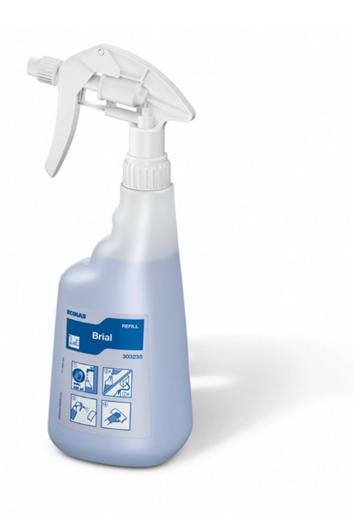
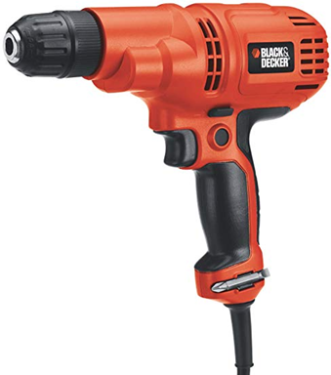
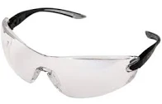
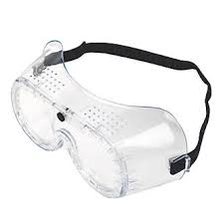
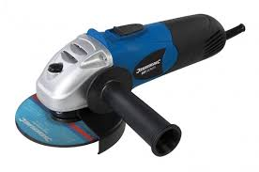
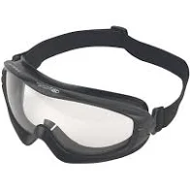
Safety Moment
1
All staff should have a PPE assessment (MAN16) which identifies whether eye protection is required for the role
Eye injuries occur everyday through the impact of objects, foreign bodies such as dirt, dust or metal fragments, or chemical splashes and sprays. The majority of these injuries can be prevented if eye protection had been worn.
If you have been issued with eye protection then wear it, it is your eyesight that it is there to protect.
2
Eye protection should be issued to each individual, it should fit properly, be suitable for the job and be in good condition.
Eye Protection
3
Care should be taken to protect eye protection from damage to scratches when it is not being worn.
Protecting your eyesight from impact, foreign bodies, and chemicals
✓
4
Do not undertake tasks that require eye protection or go into areas that require eye protection unless you are wearing it.
Dust and dirt
✓
Safety glasses
Chemical spray
5
If you are in any doubt about whether you should be wearing eye protection for the task, STOP and speak to your manager or supervisor.
✓
Safety goggles
Sparks and metal fragments
Slim goggles
HS/SC/005/01 Internal Use 11 November 19

