Slide 1









COSHH HAZARD ICONS
HS/G/002/03

Slide 2


















PPE ICONS
Minute Clocks (Contact Time)
HS/G/002/03

Slide 3









CLEANING ICONS
HS/G/002/03

Slide 4






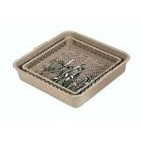
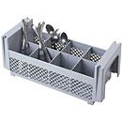
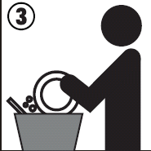


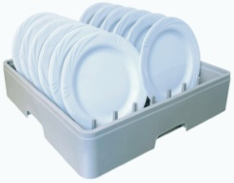

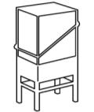
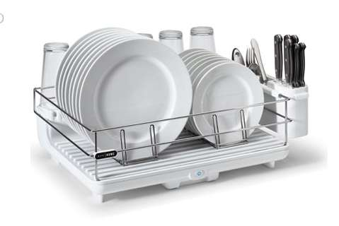
Original ECOLAB ICONS
HS/G/002/03

