Slide 1

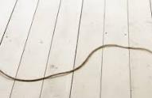
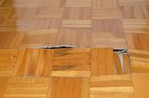

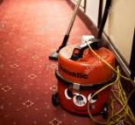

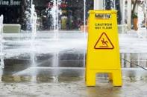
Safety Moment
1
Watch where you walk
Be aware of where you are walking. Look down for spilled liquids, materials, equipment, changing surface levels, boxes etc.
Slips trips and falls are the biggest single cause on injury across our organisation. Most of these incidents occur because of poor housekeeping and most would be preventable with a little care.
2
Wear correct footwear
Make sure your safety shoes are in good shape and correct for the job. Replace worn-out shoes with smooth soles and other defects.
Preventing Slips, Trips and Falls
Preventing injuries by taking a little more care
3
Turn the lights on
Make sure the area where you are walking is well lit or use a torch if lighting is poor.
4
Be careful on stairs
Do not run when going up or down stairs. Check to see that stair treads are in good shape, with no obstructions on the steps. Always use the hand rails that are provided.
Trailing cables
Discarded boxes
Uneven floors
5
Take extra care when carrying
Avoid carrying large loads when going up or down stairs and ensure that stairs are well lit.
Discarded equipment
Refuse bags
Wet floors
HS/SC/020/01 Internal Use 12 December 19

