Slide 1

STEAMPLICITY TRAINING GUIDE
What is Steamplicity
HACCP Briefing
Benefits of Steamplicity
Step Training Guide

Slide 2
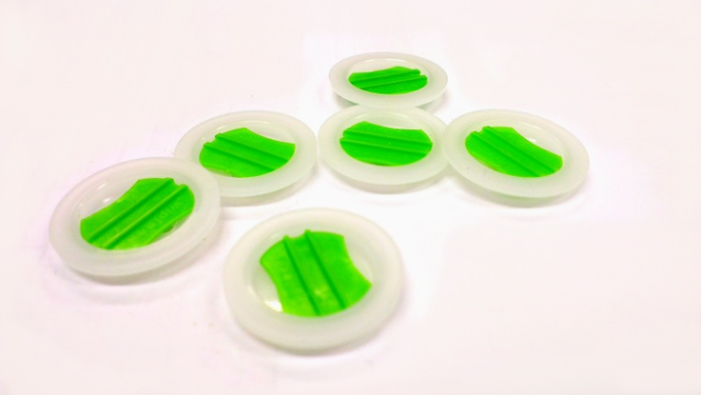
STEAMPLICITY TRAINING GUIDE
“A method of cooking using steam pressure that provides greater choice and flexibility at mealtimes.”
“Steam Pressure Cooking for the Microwave!”

Slide 3
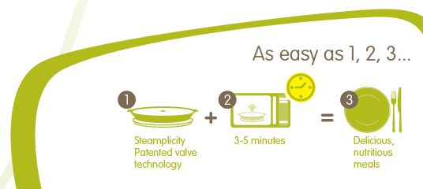
STEAMPLICITY TRAINING GUIDE
What is Steamplicity?
Steam pressure cooking for the microwave
Foods cooked within approx. 3 - 5 minutes
The process allows different items to be cooked together
e.g. raw vegetables, raw fish, meat or poultry cooked together
Consistency

Slide 4
STEAMPLICITY TRAINING GUIDE
H.A.C.C.P

Slide 5
STEAMPLICITY TRAINING GUIDE
What is HACCP
Application HACCP
Evidence of HACCP
Critical Control Points
Summary

Slide 6
STEAMPLICITY TRAINING GUIDE
What is HACCP?
A food safety system used by the food industry
Contains CCP (critical control points)
Will provide the user with due diligence
in food safety

Slide 7
STEAMPLICITY TRAINING GUIDE
HACCP Application
Establish the monitoring system for the
control of the CCPs.
Monitor the CCPs and take corrective action
where required.
Review HACCP every 6 months.
Ensure team understand HACCP.

Slide 8
STEAMPLICITY TRAINING GUIDE
CCP 1 – Food Delivery
Before offloading check vehicle temperature
Check use by date of product
Record food temperature
Remove to chilled storage within 30 minutes

Slide 9
STEAMPLICITY TRAINING GUIDE
CCP 2 – Food Storage
Stacked 3 high or less where possible on shelves to prevent slippage of the food
Check for stock rotation, food and chiller temperature, the use by date, allergen information and out of date stock removed
Keep refrigeration and storage area clean and tidy

Slide 10
STEAMPLICITY TRAINING GUIDE
CCP 6 – Cooking
Food cooked to correct temperature
Food standing time is observed
Record temperature on relevant sheet (including boost)
Plate is wiped and covered
Served to customer within 15 minutes

Slide 11
STEAMPLICITY TRAINING GUIDE
Health and Safety
Refrigeration
Ensure your refrigeration will hold at the correct temperature
Avoiding Burns
Allow product to rest for 30 seconds, peel film carefully
Use a clean cloth if required
Daily Checking of Electrical Equipment
Microwaves should be visually checked in line accepted procedure

Slide 12
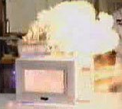
STEAMPLICITY TRAINING GUIDE
Health and Safety
Cleaning Schedule
Microwaves must be added to your cleaning schedule (where relevant)
Super Boiling of liquids
Microwaves should not be used for the heating or boiling of liquids
Fire Safety
If a fire starts inside the Microwave oven under no
circumstances open the door to the Microwave.
Isolate the Microwave if possible and raise the Alarm.

Slide 13
STEAMPLICITY TRAINING GUIDE
Due Diligence
Product handling:
Correct Storage – Fridge and delivery temp 0 – 5⁰ C
Correct temperature – meal cooking 82⁰C for meals and 75°C for jacket potatoes and puddings
Check seal is complete
Labels missing (use by date)
Allergen information is correct and legible

Slide 14
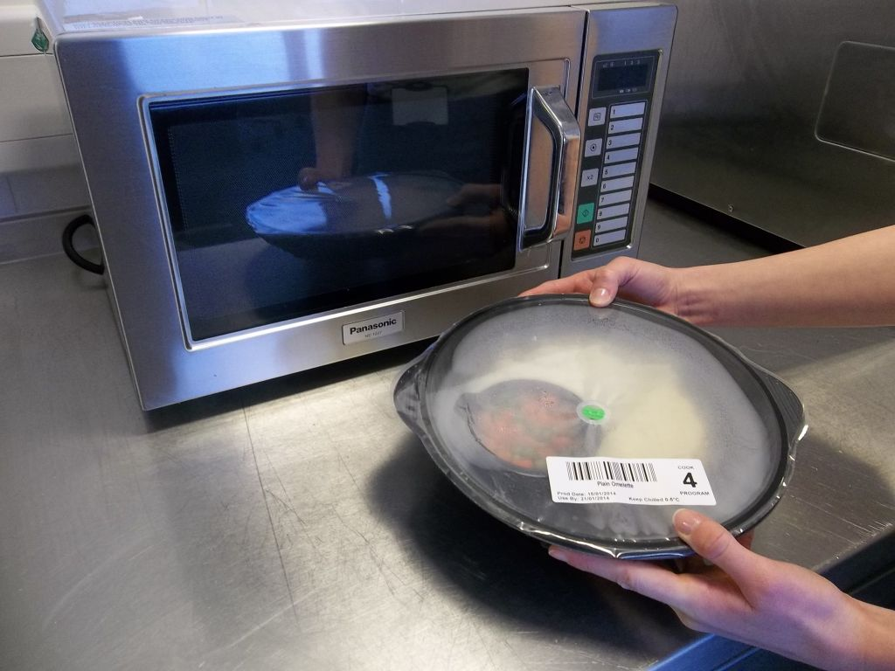
STEAMPLICITY TRAINING GUIDE
Steamplicity Cooking
Method
Steamplicity oven
Follow Step training Guide
See 4 press 4
Cook food

Slide 15
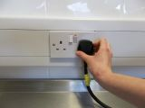
STEAMPLICITY TRAINING GUIDE
Step 1
Only use the correct microwave ovens.
Ensure that the microwave is plugged in and the oven is working.

Slide 16
STEAMPLICITY TRAINING GUIDE
Step 2
Look to check that the seal
is intact and the meal is in date

Slide 17
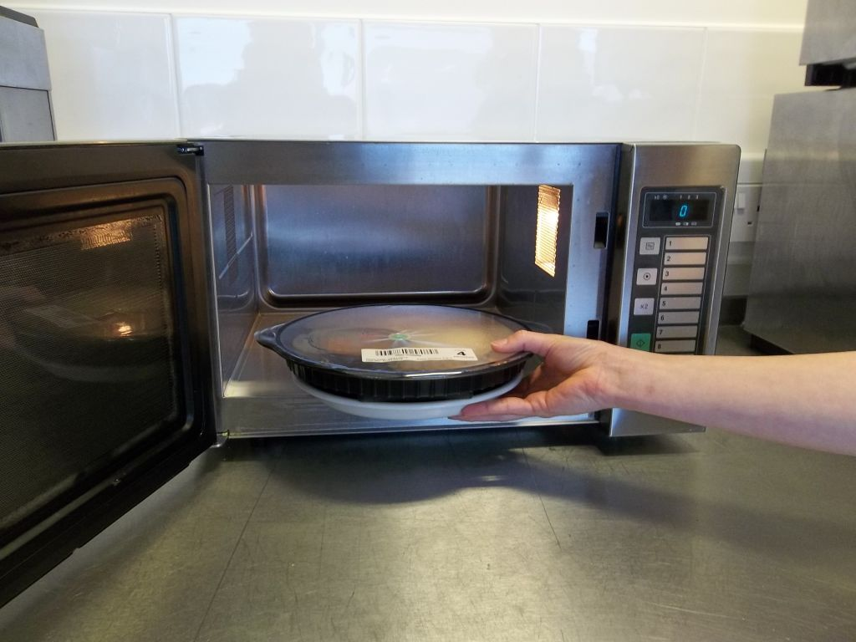
STEAMPLICITY TRAINING GUIDE
Step 3
Place on the appropriate plate or dish
Valve upwards
Place one meal at a time into the microwave
Note: The blue plate is not suitable for microwave cooking

Slide 18
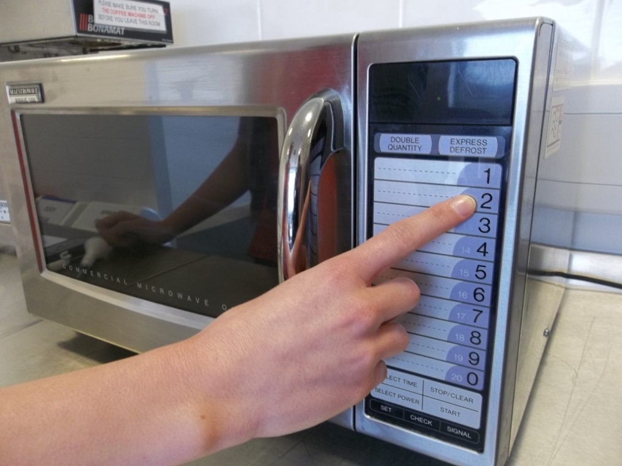
STEAMPLICITY TRAINING GUIDE
Step 4
Press the correct button according to the programme number on the label

Slide 19
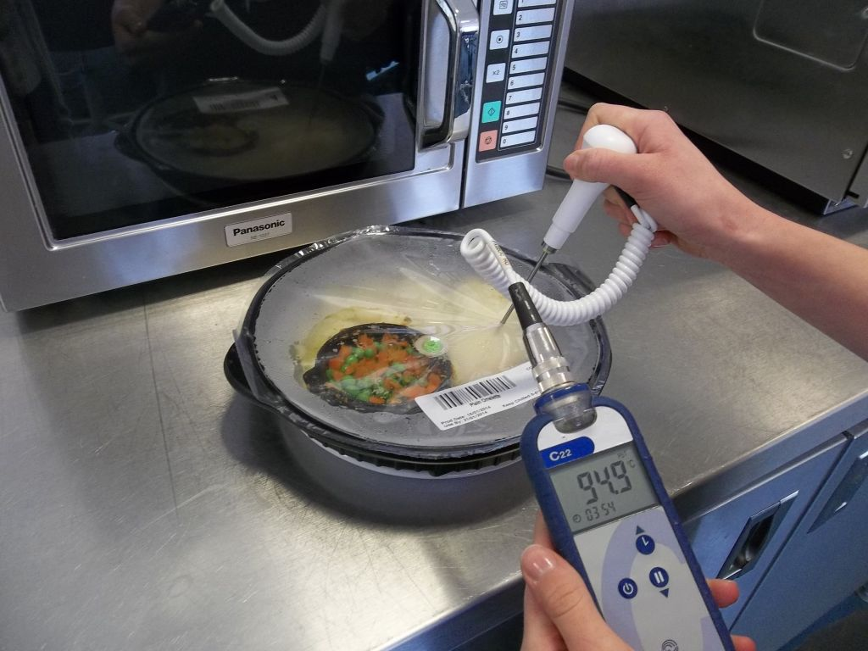
STEAMPLICITY TRAINING GUIDE
Step 5
After cooking, leave for
around 30 seconds then
temperature probe the main protein item.
The temperature should
reach 82°C or above
If above 82°C , record the
temperature and go to step 9

Slide 20
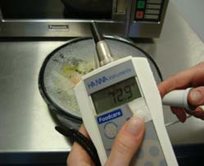
STEAMPLICITY TRAINING GUIDE
Step 6
Critical Control
If the temperature is below 82°C, return meal to microwave

Slide 21
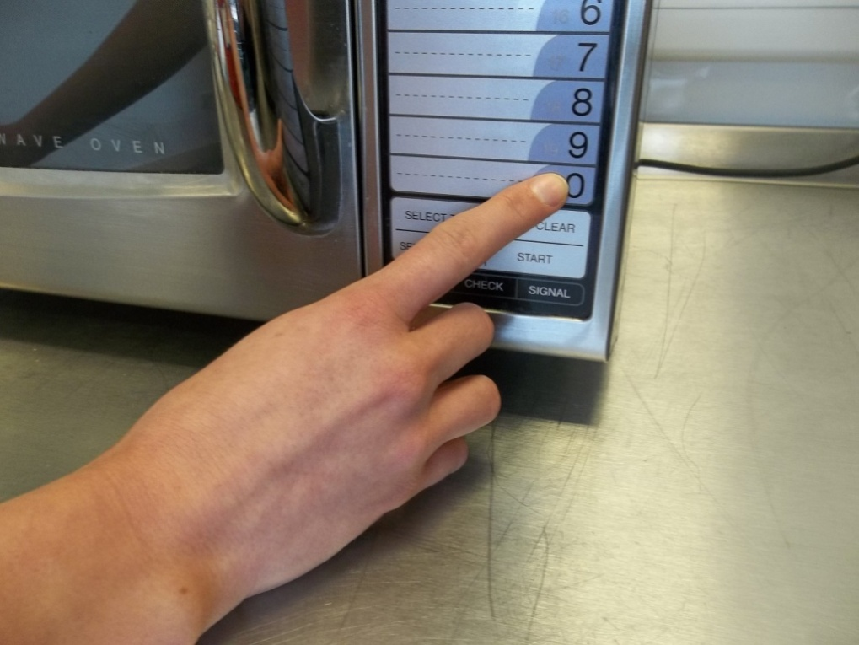
STEAMPLICITY TRAINING GUIDE
Step 7
Press “0” which is a 30 second
boost cycle

Slide 22
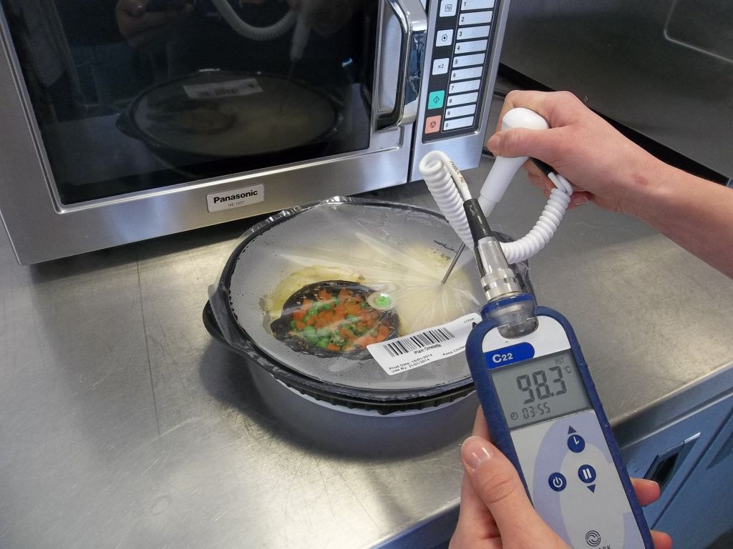
STEAMPLICITY TRAINING GUIDE
Step 8
Once finished , probe again to ensure temperature is 82°C or above
Record the temperature on the daily cooking record sheet.
If the meal has not reached 82°C dispose of the meal

Slide 23
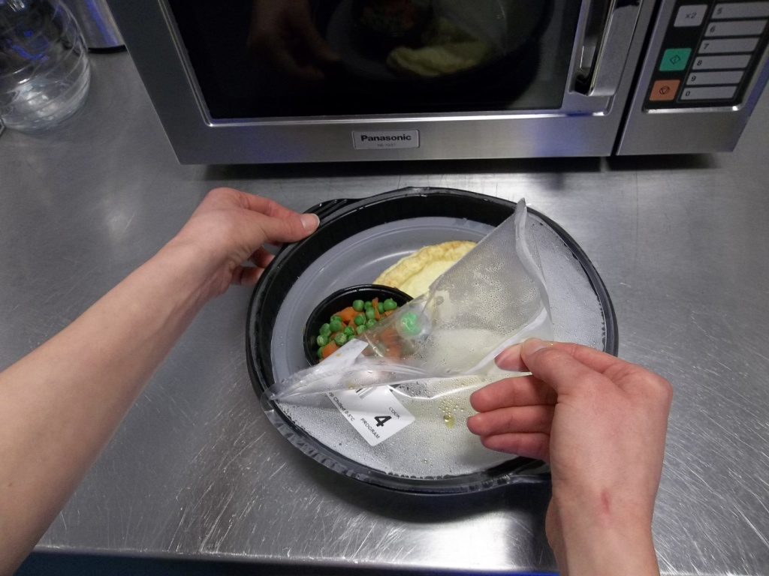
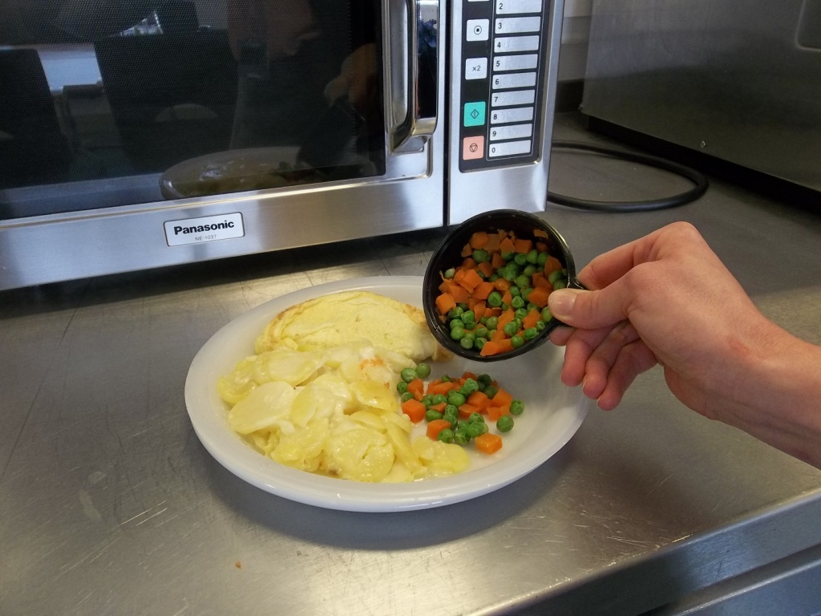
STEAMPLICITY TRAINING GUIDE
Step 9
Holding the lip, carefully peel the film keeping fingers away from the escaping steam
Place the meal onto the blue or china plate and if using a vegetable pot tip the contents onto the plate.

Slide 24
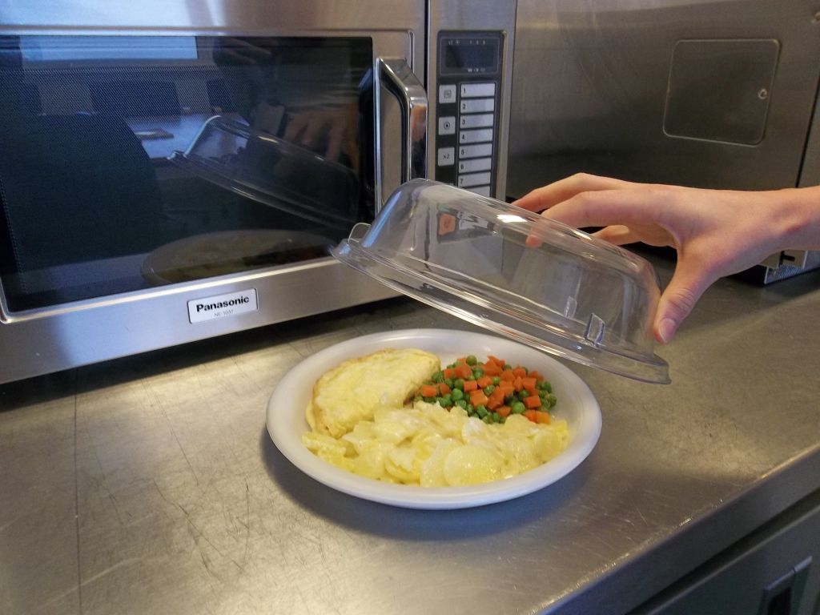
STEAMPLICITY TRAINING GUIDE
Step 10
Wipe the rim with a paper towel and cover the meal with a plate cover.
Place onto the tray and serve immediately.

Slide 25
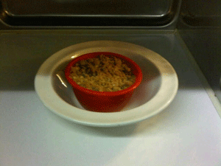
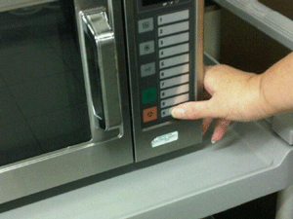
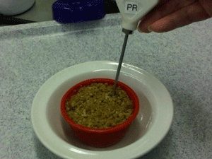
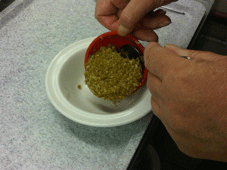
STEAMPLICITY TRAINING GUIDE
Desserts
Unwrap dessert and place in bowl
Press button “0” for sponges
Press button “9” for Crumbles
Leave for 15 seconds,
Take temperature ( 75ºC)
Boost for 15 seconds if required

Slide 26
STEAMPLICITY TRAINING GUIDE
Where do you find the cooking programme number ?
What temperature should the food reach during cooking?
How do you know that the food is at the correct temperature?
How many do you cook at any time?
What do you do when the meal is cooked and plated?
What temperature should the fridge hold the food at?
Let test your understanding

Slide 27
STEAMPLICITY TRAINING GUIDE
And now the answers
Where do you find the cooking programme number ?
Product label or retail sleeve
What temperature should the food reach during cooking?
82° degrees or 75 for puddings and jacket potatoes
How do know if the hot food is at the right temperature?
Temperature probe the core element of the dish
How many meals do you cook at any time?
only 1
What do you do when the meal is cooked and plated?
Wipe the edge of the plate or bowl with a clean paper towel
What temperature should the fridge hold the food at?
0 – 5 degrees

Slide 28
STEAMPLICITY TRAINING GUIDE
In Summary
Steamplicity – Steam pressure cooking
Delivering consistency and quality
Improving quality for the customer
Flexible meal times
Dedicated HACCP

