Slide 1

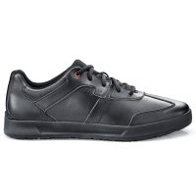
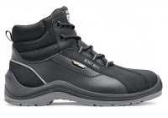
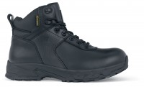
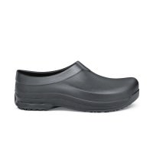
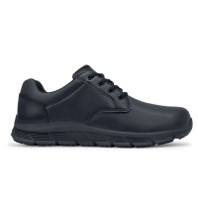
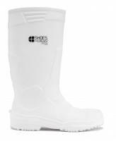

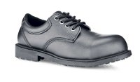
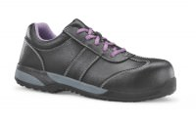
Safety Moment
1
The right footwear for the task
Use the PPE Assessment Form (MAN16) to identify PPE requirements. Think about all aspects of the task and the floor surfaces .
Safety footwear is a fundamental part of the the personal protective equipment we provide to colleagues to help keep them safe at work. But for it to be effective its needs to be the right footwear for the task and it needs to be worn.
2
Issue to all colleagues
Ensure all colleagues undertaking the task are issued with the correct footwear, some may need to have more than one type of footwear. Record using MAN16 issue form
Safety Footwear
Wearing the right shoe or boot to provide the right level of protection
3
Check usage
Ensure colleagues are wearing the footwear they have been issued with. No exceptions.
Non-slip shoes,
no toecap protection
Kitchens, front of house, cleaners
4
Check condition
Check that the footwear is in good condition and remains suitable for the task. If it is not, then issue new footwear and record on MAN16.
Non-slip boots with toecap protection
Porters, drivers, maintenance
Non-slip shoes
with toecap protection
Kitchens, porters, janitors, maintenance
Specialist
footwear
5
If in doubt, stop!
Don’t expose colleague to a slip or trip if they are not wearing the correct footwear

