Slide 1
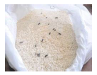
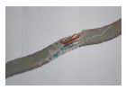
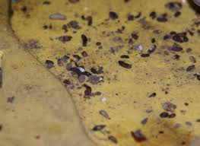
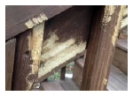
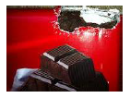
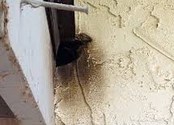
Safety Moment
1
Pest control treatment should only be carried out by a specialist contractor.
Report any pest activity immediately and arrange for a pest control contractor to attend.
We have a legal duty to prevent contamination of food from pests. A pest is any animal, insect or bird that can damage or contaminate food. Common pests include rats, mice, birds, cockroaches, flies and stored product insects, such as weevils, beetles and mites.
Many animals, birds and insect pests carry food poisoning bacteria which can cause illness.
2
Floors. Sweep up droppings/clear urine/grease with disposable paper towel before mopping and disinfecting floor.
Pest Control
3
Shelvings/surfaces. Remove any debris/contamination. Clean with soapy cloth then disinfect and wipe with disposable paper towel.
Preventing animals and pests from causing contamination of food
4
Unprotected crockery/utensils must be washed (cleaned) prior to placing in the dishwasher (disinfection)
5
Any food/packaging found to have evidence of pest damage must be disposed of.
Contaminated food
Chewed cables
Droppings
6
Consult Good Hygiene Practice Guide No.3 on Pest Control to decide whether the unit is fit to trade.
If in doubt contact your HSE Manager.
Gnaw marks
Grease marks
HS/SC/006/01 Internal Use 11 November 19
Damaged packaging

