Slide 1


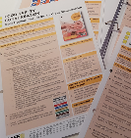
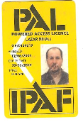

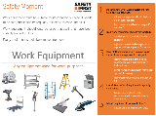
Safety Moment
1
Training
  Are all colleagues up-to-date with Compass e-learning?
  Have managers completed the H&S for Managers e-learning?
  Is all statutory training up-to-date?
It is vital that the people we work with know how to work safely and without risks to health. This helps build a positive health and safety culture where safe working becomes second nature to everyone. Its also out legal duty to ensure everyone is ‘competent’.
Competence is more than just training, it also comes from the information we provide colleagues, the supervision we give them to follow safety rules, and the skills and experience they develop in their jobs.
2
Skills
  Do colleagues in skilled positions have the right skillsets?
  Do we regularly observe the skills of colleagues at work?
  Are tasks rotated to keep colleagues skills up-to-date?
Competence
Training, skills, experience and knowledge
3
Experience
  Are colleagues experienced at using specialist tools/equipment?
  Have they previously worked in similar environments?
Safety
Conversations/
Toolbox talks
4
Knowledge
  Do you regularly check your colleagues safety knowledge?
  Do you undertake regular safety moments and toolbox talks?
Supervision
Qualifications
Posters
Safety Moments
HS/SC/002/01 Internal Use April 2019

