Slide 1

STEAMPLICITY MULTIPORTION TRAINING GUIDE
What is Steamplicity
HACCP Briefing
Benefits of Steamplicity
Step Training Guide
Document Name | Multiportion Training Guide 2018 | Document No | HC/FS/G/003
Document Owner | Alison Preston | Date of Issue | Nov 2018
Classification | Internal Use | Version No | 02

Slide 2
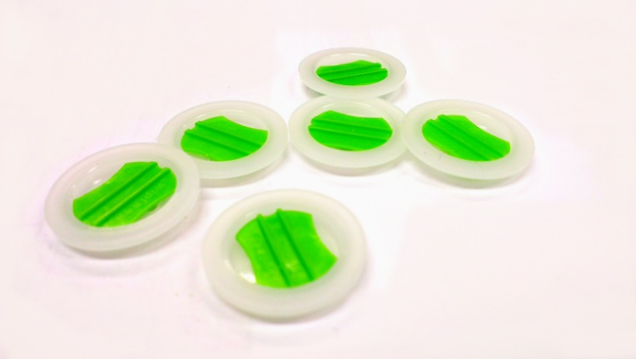
STEAMPLICITY MULTIPORTION TRAINING GUIDE
“A method of cooking using steam pressure that provides greater choice and flexibility at mealtimes.”
“Steam Pressure Cooking for the Microwave!”
HC/FS/G/003/02 November 2018 2 of 27

Slide 3
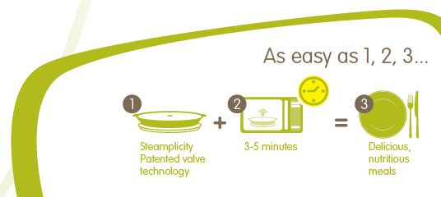
STEAMPLICITY MULTIPORTION TRAINING GUIDE
What is Steamplicity?
Steam pressure cooking for the microwave
Foods cooked within approx. 4 - 9 minutes
The process allows different items to be cooked together
e.g. raw vegetables, raw fish, meat or poultry cooked together
Consistency
HC/FS/G/003/02 November 2018 3 of 27

Slide 4
STEAMPLICITY MULTIPORTION TRAINING GUIDE
H.A.C.C.P
HC/FS/G/003/02 November 2018 4 of 27

Slide 5
STEAMPLICITY MULTPORTION TRAINING GUIDE
What is HACCP
Application HACCP
Evidence of HACCP
Critical Control Points
Summary
HC/FS/G/003/02 November 2018 5 of 27

Slide 6
STEAMPLICITY MULTIPORTION TRAINING GUIDE
What is HACCP?
A food safety system used by the food industry
Contains CCP (critical control points)
Will provide the user with due diligence
in food safety
HC/FS/G/003/02 November 2018 6 of 27

Slide 7
STEAMPLICITY MULTIPORTION TRAINING GUIDE
HACCP Application
Establish the monitoring system for the
control of the CCPs.
Monitor the CCPs and take corrective action
where required.
Review HACCP every 6 months.
Ensure team understand HACCP.
HC/FS/G/003/02 November 2018 7 of 27

Slide 8
STEAMPLICITY MULTIPORTION TRAINING GUIDE
CCP 1 – Food Delivery
Before offloading check vehicle temperature
Check use by date of product
Record food temperature
Remove to chilled storage within 30 minutes
HC/FS/G/003/02 November 2018 8 of 27

Slide 9
STEAMPLICITY MULTIPORTION TRAINING GUIDE
CCP 2 – Food Storage
Store on shelf correctly
Check for stock rotation, food and chiller temperature, the use by date, allergen information and out of date stock removed
Keep refrigeration and storage area clean and tidy
HC/FS/G/003/02 November 2018 9 of 27

Slide 10
STEAMPLICITY MULTIPORTION TRAINING GUIDE
CCP 6 – Cooking
Food cooked to correct temperature +75°C (82°C in Scotland)
Food standing time is observed
Record temperature on relevant sheet (including boost)
Food is placed into serving tray before placing onto counter and food is above +63°C or hotter during service
HC/FS/G/003/02 November 2018 10 of 27

Slide 11
STEAMPLICITY MULTIPORTION TRAINING GUIDE
Health and Safety
Refrigeration
Ensure your refrigeration will hold at the correct temperature
Avoiding Burns
Allow product to rest for 1 minute, peel film carefully
Use a clean cloth if required
Daily Checking of Electrical Equipment
Microwaves should be visually checked in line accepted procedure
HC/FS/G/003/02 November 2018 11 of 27

Slide 12
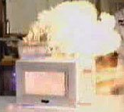
STEAMPLICITY MULTIPORTION TRAINING GUIDE
Health and Safety
Cleaning Schedule
Microwaves must be added to your cleaning schedule (where relevant)
Super Boiling of liquids
Microwaves should not be used for the heating or boiling of liquids
Fire Safety
If a fire starts inside the Microwave oven under no
circumstances open the door to the Microwave.
Isolate the Microwave if possible and raise the Alarm.
HC/FS/G/003/02 November 2018 12 of 27

Slide 13
STEAMPLICITY MULTIPORITON TRAINING GUIDE
Due Diligence
Product handling:
Correct Storage – Fridge and delivery temp 0 – 5⁰ C
Correct temperature – meal cooking 75°C (82°C in Scotland)
Check seal is complete
Labels missing (use by date)
Allergen information is correct and legible
HC/FS/G/003/02 November 2018 13 of 27

Slide 14
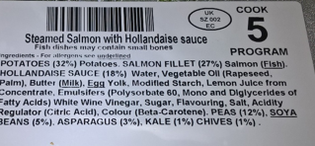
STEAMPLICITY MULTIPORTION TRAINING GUIDE
Steamplicity Cooking
Method
Steamplicity oven
Follow Step training Guide
See 5 press 5
Cook food
HC/FS/G/003/02 November 2018 14 of 27

Slide 15
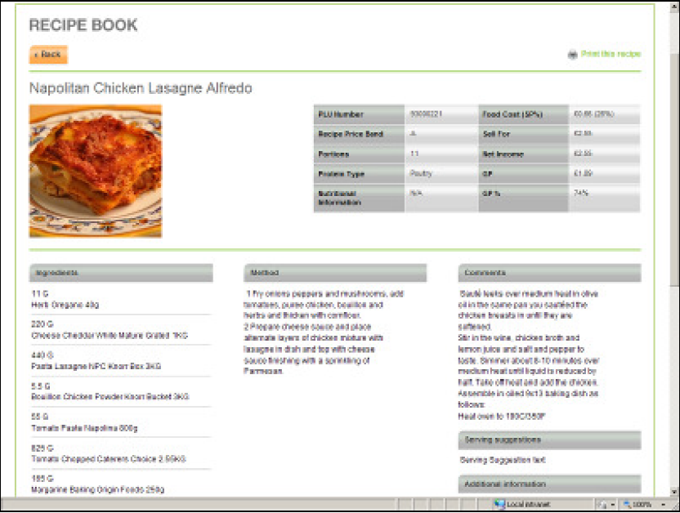

STEAMPLICITY MULTIPORTION TRAINING GUIDE
Step 1
Print off and review the information from the source
HC/FS/G/003/02 November 2018 15 of 27

Slide 16
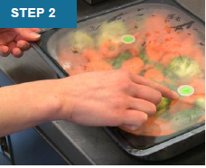
STEAMPLICITY MULTIPORTION TRAINING GUIDE
Step 2
Look to check that the seal
is intact and the meal is in date
HC/FS/G/003/02 November 2018 16 of 27

Slide 17
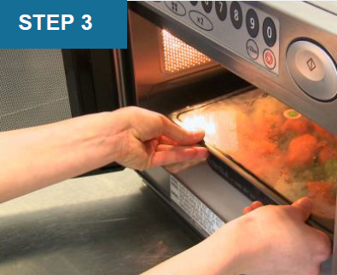
STEAMPLICITY MULTIPORTION TRAINING GUIDE
Step 3
Place one tray at a time in the microwave
HC/FS/G/003/02 November 2018 17 of 27

Slide 18
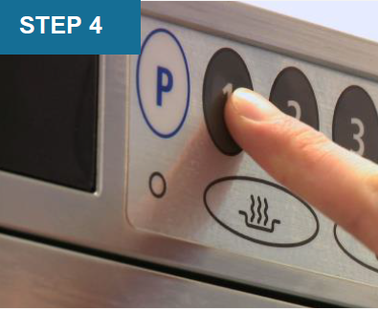
STEAMPLICITY MULTIPORTION TRAINING GUIDE
Step 4
Press the correct button according to the programme number on the label
HC/FS/G/003/02 November 2018 18 of 27

Slide 19
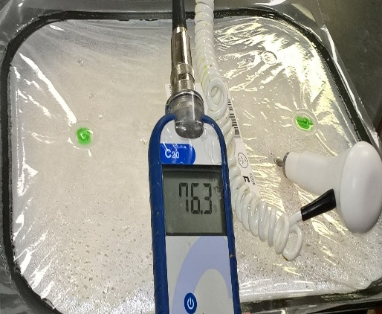
STEAMPLICITY MULTIPORTION TRAINING GUIDE
Step 5
After cooking, leave to stand for 1 minute, insert probe through top film to temperature check the food. If above 75⁰C (82⁰C Scotland), record on daily Steamplicity record sheet and go to Step 8. If not, continue to Step 6.
STEP 5
HC/FS/G/003/02 November 2018 19 of 27

Slide 20
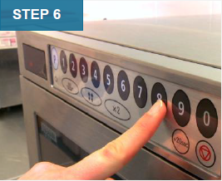
STEAMPLICITY MULTIPORTION TRAINING GUIDE
Step 6
Critical Control
Press 0 for 1 minute of extra cooking
HC/FS/G/003/02 November 2018 20 of 27

Slide 21
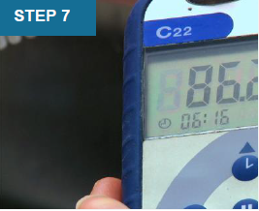
STEAMPLICITY MULTIPORTION TRAINING GUIDE
Step 7
Probe the food again to ensure the temperature is now above 75°C (82°C Scotland)
HC/FS/G/003/02 November 2018 21 of 27

Slide 22
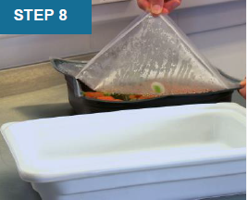
STEAMPLICITY MULTIPORTION TRAINING GUIDE
Step 8
Holding the tray, carefully peel the film, keeping fingers away from escaping steam.
HC/FS/G/003/02 November 2018 22 of 27

Slide 23
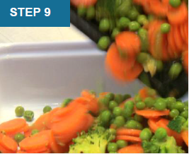
STEAMPLICITY MULTIPORTION TRAINING GUIDE
Step 9
Decant the food into the appropriate serving dish. Always decant or replenish back of house, Steamplicity trays should not be taken front of house
HC/FS/G/003/02 November 2018 23 of 27

Slide 24
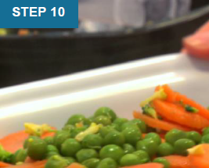
STEAMPLICITY MULTIPORTION TRAINING GUIDE
Step 10
Garnish the food as per The Source recipe instruction and place on counter. Ensure the food is above 63°C during service
HC/FS/G/003/02 November 2018 24 of 27

Slide 25
STEAMPLICITY MULTIPORTION TRAINING GUIDE
Where do you find the cooking programme number ?
What temperature should the food reach during cooking?
How do you know that the food is at the correct temperature?
How many do you cook at any time?
What do you do when the meal is cooked?
What temperature should the fridge hold the food at?
Let test your understanding
HC/FS/G/003/02 November 2018 25 of 27

Slide 26
STEAMPLICITY MULTIPORTION
TRAINING GUIDE
And now the answers
Where do you find the cooking programme number ?
Product label or retail sleeve
What temperature should the food reach during cooking?
75°C or 82°C for Scotland
How do know if the hot food is at the right temperature?
Temperature probe the core element of the dish
How many meals do you cook at any time?
only 1
What do you do when the meal is cooked?
Decant into serving dish
What temperature should the fridge hold the food at?
0 – 5 degrees
HC/FS/G/003/02 November 2018 26 of 27

Slide 27
STEAMPLICITY MULTIPORTION TRAINING GUIDE
In Summary
Steamplicity – Steam pressure cooking
Delivering consistency and quality
Improving quality for the customer
Dedicated HACCP
HC/FS/G/003/02 November 2018 27 of 27

