Slide 1
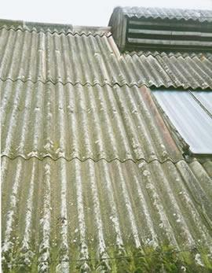
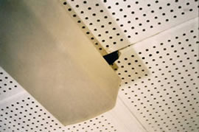
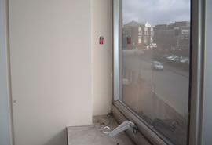
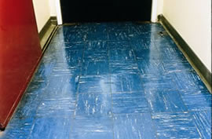
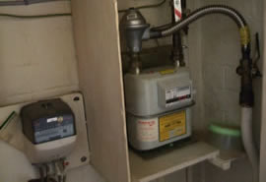
Safety Moment
1
Asbestos information
Has the client provided Asbestos Register information?
When was it last updated?
Does the Asbestos Register cover the areas that you work in?
More people are killed by exposure to asbestos each year than are killed on the roads. Exposure can lead to asbestos-related diseases that can seriously affect health many years later.
We all need to be aware of the hazards of asbestos, where it can be found, what we need to do if it is disturbed. This is the case for any area we work, whether it be kitchens, store cupboards, plant rooms or workshops.
2
Managing our work
Do you understand how our work may disturb or damage asbestos materials?
Do we have contractors doing work in areas that contain asbestos materials?
Preventing Asbestos
Exposure
3
Communication
Do staff understand whether there are asbestos materials in the areas they work?
Do staff understand procedures to follow if asbestos materials are disturbed or damaged?
Greatest single cause of work-related deaths in the UK
4
Get advice if you are unsure
If in doubt STOP WORK, ask for help.
Contact your manager or the HSE team hse2@compass-group.co.uk
HS/SC/001/01 Internal Use April 2019

