Slide 1
Vacherin Monthly H&S Meeting
June 2025

Slide 2
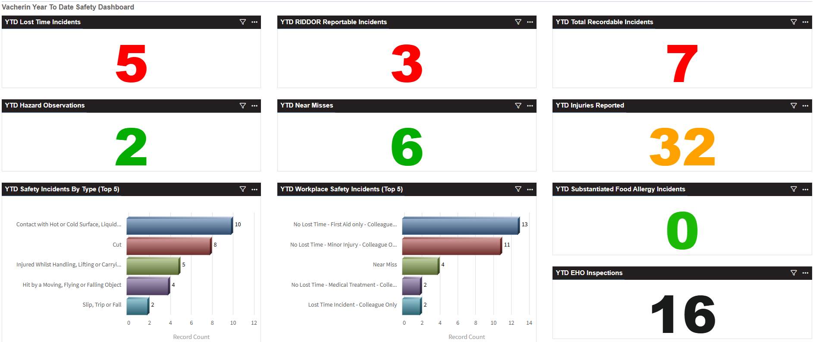
Vacherin Year to date stats

Slide 3
Vacherin May incidents summary
1 x near miss reported in May
(trip hazard - loose carpet where a trolley was wheeled) 1 x burn incident which resulted in 6 days lost time (oil burn from attempting to move a counter-top fryer whilst still hot)
1 x burn from contact with hot counter (first aid only)
2 x reported EHO visits for May 1 x Foreign body incident (Appeared to be a bird dropping in a bag of coffee beans - vendor assurance investigating) 1 x Alleged allergic reaction from a nut and peanut sufferer (Investigation concluded unsubstantiated – all controls in place)

Slide 4
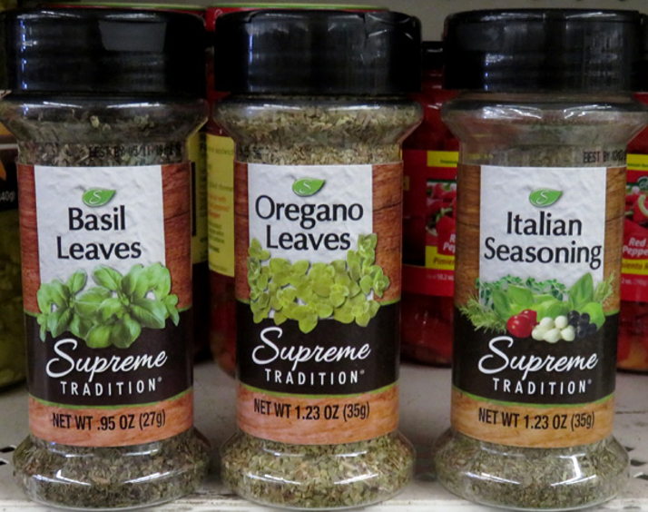
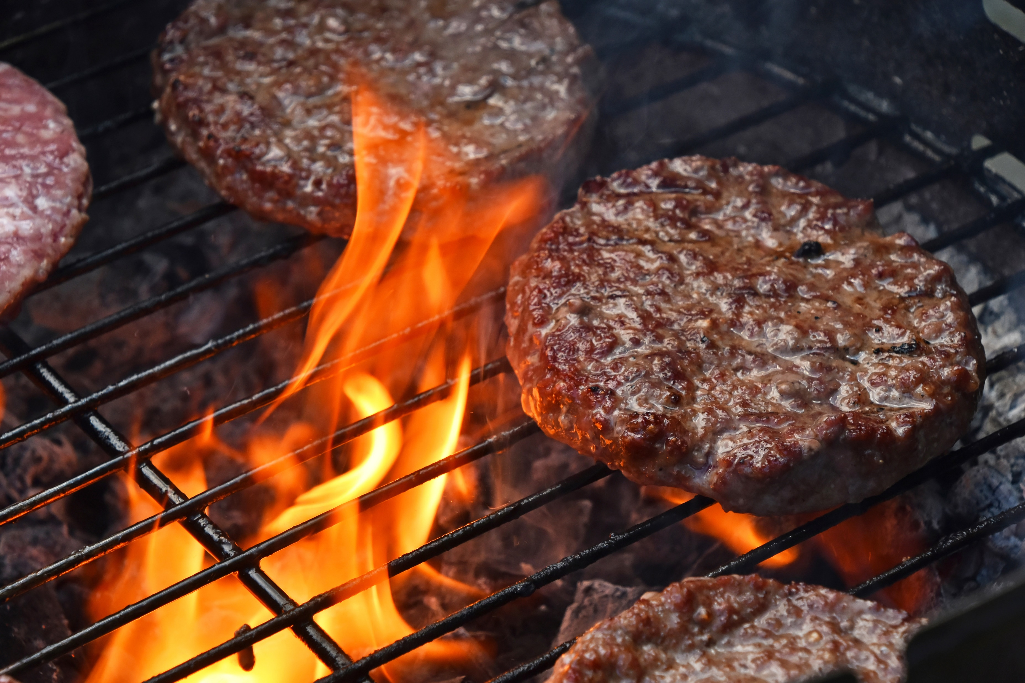
June See Care Share
In focus:
Dried herbs and spices: Follow manufacturer instructions Add to food during the cooking process to kill any harmful bacteria which may be present
Do not add to RTE foods
Safety on stairs
Barbecue safety tips at home
Double click image for the PDF
This Photo by Unknown Author is licensed under CC BY-SA

Slide 5
Stairs and steps safety
Double click images for the PDFs

Slide 6
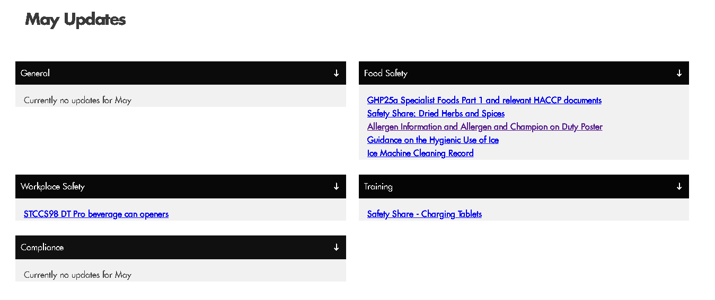
HSE website updates
A dedicated page has been added to the HSE website which details updates (also accessible under the Compliance tab > Website updates)
Broken down into categories

Slide 7
Important updates
The processes in GHP 25a Specialist Foods Part 1 no longer require HSE approval Pickles, Chutneys, Jams, Gels and Syrups, Flavoured Oils, Yoghurt and Labneh 1. GHP 25a Specialist Foods Part 1 need to be trained out to the team carrying out the processes 2. This needs to be captured on their FSMS training record card
3. Hazard Analysis Records need signing and adding to your FSMS folder (Pickles, Chutneys, Jams, Gels and Syrups, Flavoured Oils, Yoghurt and Labneh)
4. Supporting documents are the pH Meter Accuracy Record and the pickles, chutneys, jams, gels, syrups and flavoured oil record
5. Remember to tick ‘Other’ on the food process flow chart too

Slide 8
Updates
Ice machine team safety briefing and Ice machine cleaning record
Double click images for the PDFs

Slide 9
Updates
Recent new or updated Safety Task Cards
Catering Services Safety Task Cards STCCS07 Use of deep fat fryers (updated) STCCS08 Cleaning of deep fat fryers (updated) STCCS95 Juicers STCCS97 Coffee Grinders STCCS98 DT Pro Beverage can opener (Draft Top Pro) STCCS99 Japanese Grills General Safety Task Cards STCGE03 Damp mopping (updated) STCGE59 Removing glass waste from accommodation blocks STCGE60 Free-burning incinerators
Where necessary:
Print & replace copies on file
Train out to the team
Brief your team on changes

Slide 10
June audit tip!
Q93. Has the Climate NET Zero Toolkit been fully completed for the site within 6 months of issue/contract start date and has it been reviewed annually?
Full details can be found My Learning > Resources Hub > System and Sector Resources > Net Zero Please complete it and save for annual review
Ways to complete it:
Double click image for the PDF
Use the editable PDF and save on laptop/PC
Complete online here
Order a paper copy from Linney

Slide 11
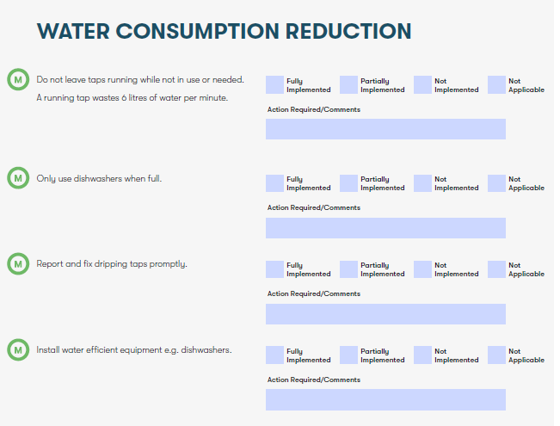
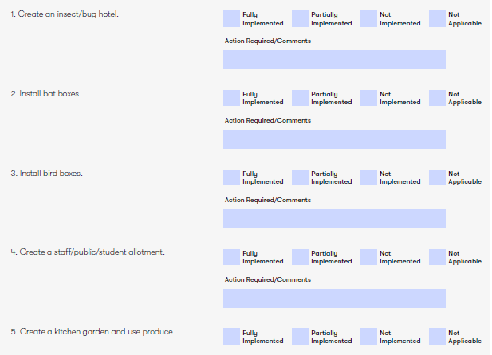
There will be sections that are not applicable - complete as required

Slide 12
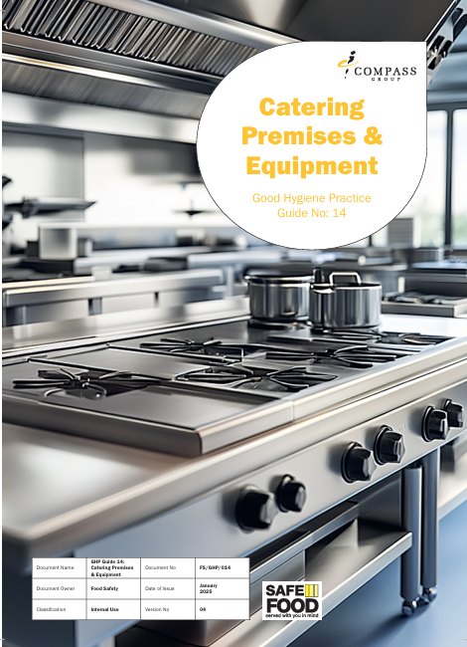
Loss of hot water procedure - An overview
The Temporary Loss of Hot Water Policy should be read in conjunction with GHP 14 Catering Premises and Equipment
This Primary Authority assured advice applies to sites in England only

Slide 13
Loss of hot water procedure - overview
Temporary loss of hot water definition
“Temporary loss of hot water is defined as a loss of the permanent hot water supply to the premises for a period not exceeding 48 hours. The 48-hour period commences from the point temporary provision of hot water to support hand washing and equipment cleaning is provided”
Temporary loss of hot water prior to food preparation and service commencing
“…if food preparation and service is yet to commence, and there is no hot water available in the kitchen or food preparation area, the kitchen must be closed, until either temporary means of hot water is provided, or a permanent supply of hot water is restored. ”

Slide 14
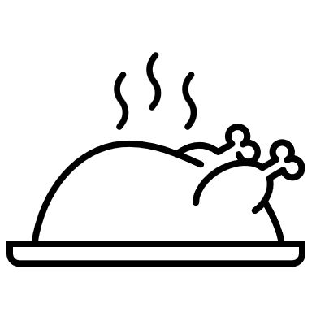
Loss of hot water procedure overview
Temporary loss of hot water but food production and service has already commenced
Where food handling and preparation has commenced, and if the whole premises, kitchen or food preparation area has no hot water, colleagues must always use the Ecolab Epicare 5C or 5AB hand wash soap to support hand washing principles. Epicare 5C and 5AB are proven to be effective when used with cold water when good hand washing techniques are adopted. Where the Unit does not have a mains-fed dishwasher, equipment must be washed with cold water using an approved cleaning chemical with sanitising properties.
Total loss of water supply (hot and cold), contamination of a water supply or flooding of units All food areas must close immediately

Slide 15
Q&A Any questions?

