Slide 1

Monthly HSE update
Company of Cooks
March 2025

Slide 2



March’s Dashboard

Slide 3
Actions not Closed off

Slide 4
Year to Date Info Charts

Slide 5
Audits in March

Slide 6
Managers Quarterly Audit
Who has done them, how to do them and sign off

Slide 7
Ops Audit
Reminder – the first of this years 2 audits needs to be completed by the end of June
The Origami Mobile app needs to be downloaded to your phones or tablets to be able to complete the audits
Then the

Slide 8
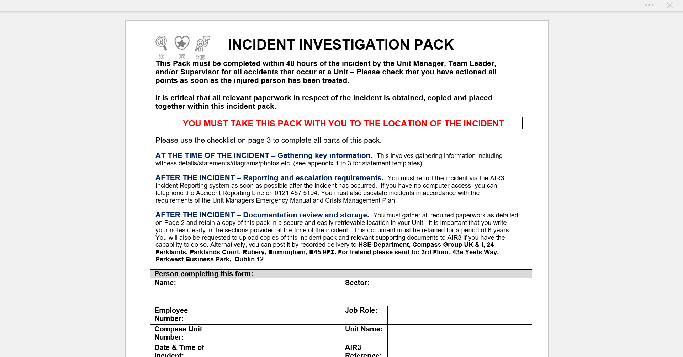
AIR3 Cases and IIP Packs
Can I please remind everyone, the Internal Investigation Pack MUST be completed and attached to ALL cases logged on Air3

Slide 9
Net Zero Toolkit
The HSE team have been concentrating on the HS part of the integration so far, but from June we will open up the Environmental part of our visits
There is the Climate Net Zero Toolkit is a booklet with asks and contains many details which covers all things Environmental within each business.
This does need to be completed on line at
https://forms.office.com/r/NymczjNzp4
More details will be coming out at a later date, but this can be
viewed under the environmental section on the HSE website and is
a question on the H&S quarterly managers audit already

Slide 10
How the HSE Team looks in Compass
Some of you might know there has been a few changes to the HSE team over the last 2 months but I wanted to let you all know the restructured team as there is a reduced number of us now
Jenny Todd is still the Head of QHSE
Myself, Michelle Howard and Maz Young are now HSE Managers and form the team for CH&Co
We are currently looking for a part time HSE Admin function as Jo Carlise has now left the business
Jason and Jo are predominantly Pablum but they will be auditing some units within the London area this year
Lana is still working in Ireland

Slide 11
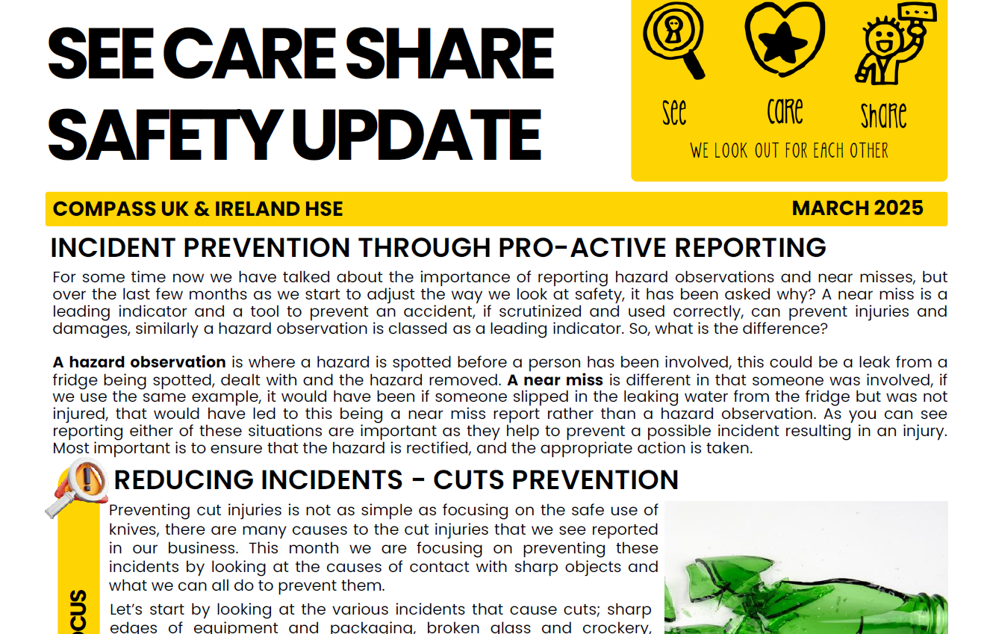
“See care share” monthly focus
These documents are replacing the
CH&Co HSE Monthly Focus
Sent out from Sharepoint to all on March13th
There is also a training card which can be
can be signed off by the team

Slide 12
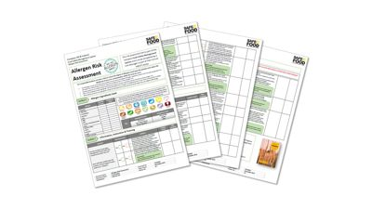
Annual allergy risk assessment
All sites must complete an Annual Allergen Risk Assessment by the deadline of 25th April.
This mandatory assessment ensures we continue to lead the way in allergen
management and is part of our continuous improvement in our food safety systems.
ACTION REQUIRE FOR ALL SITES
Download and complete the Allergen Risk Assessment Form
Action any issues raised from completing the form
Upload any actions taken to AIR3 (Origami) – on the link below
Upload the completed form to AIR3 by the deadline of 25th April
If you have already completed an Allergen Risk Assessment you do not need to repeat it, just upload the completed form to AIR3.
An email from Sharepoint was sent to all on March 10th
How to Upload your Allergen Risk Assessment to AIR3_FS.G.021.01.pdf

