Slide 1
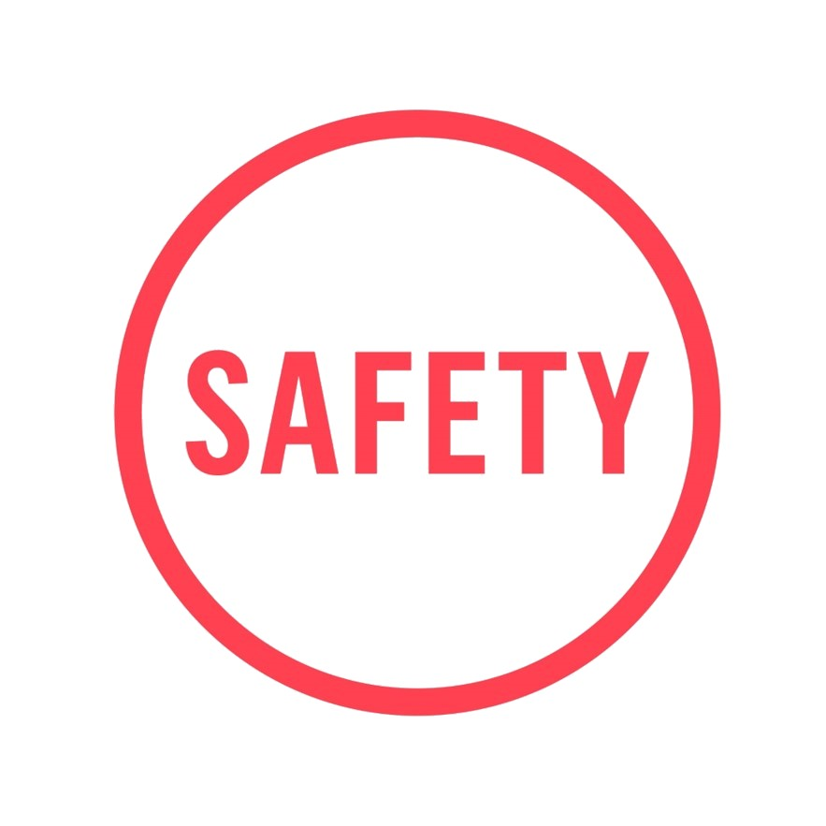
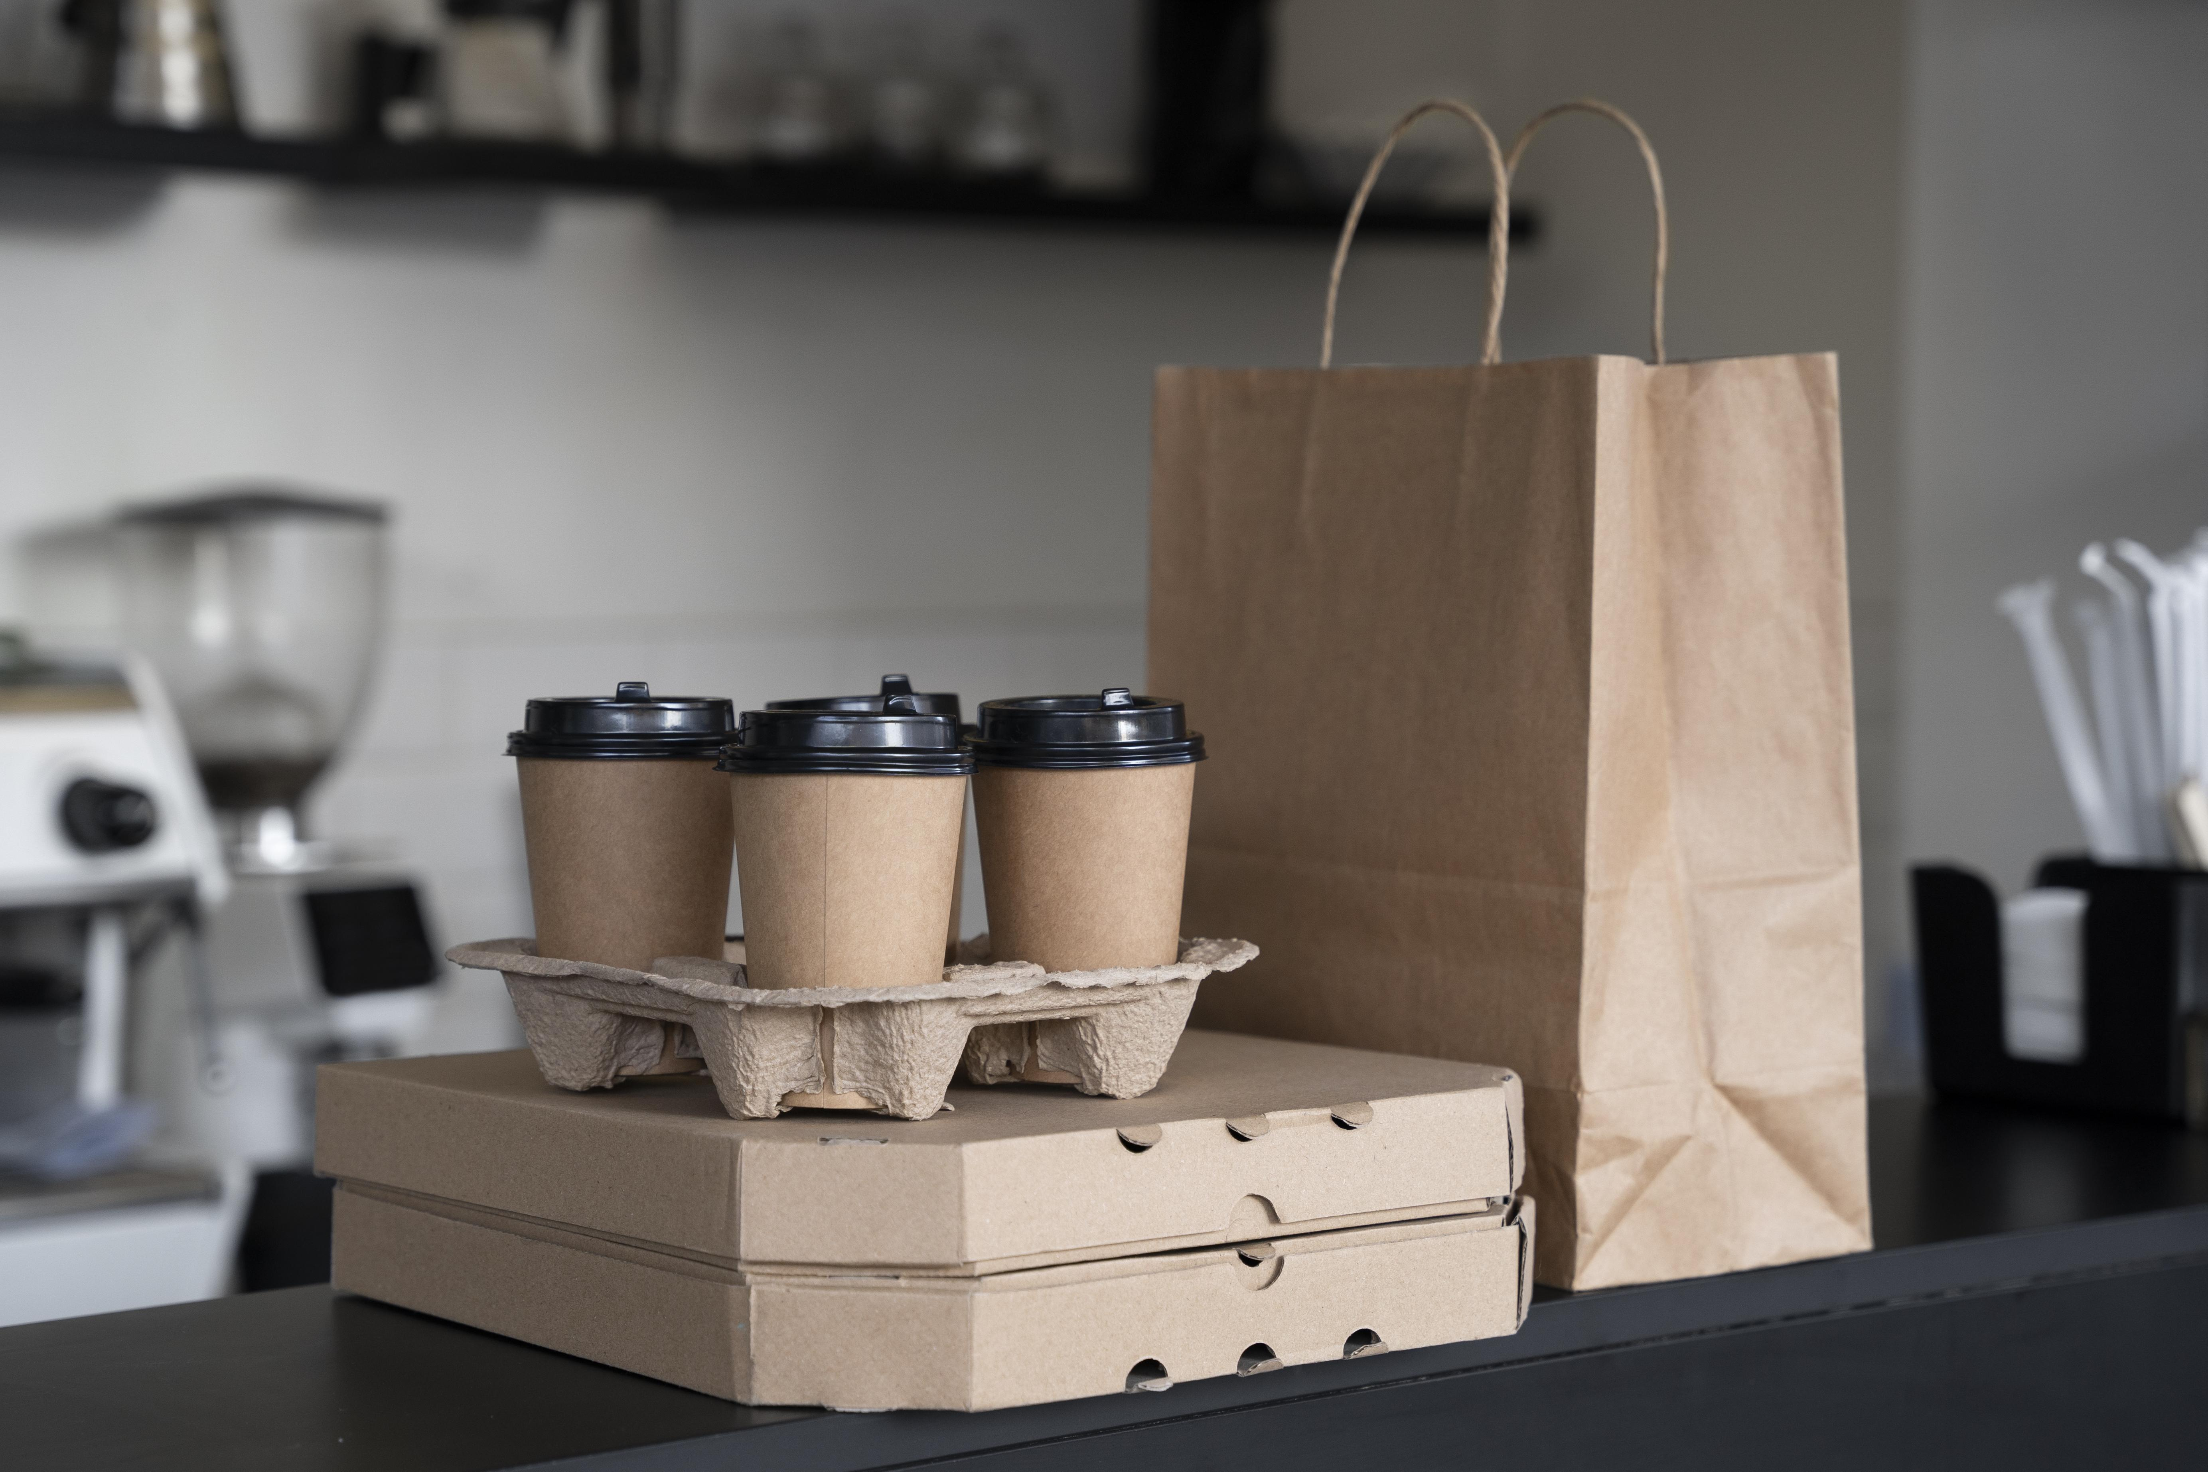
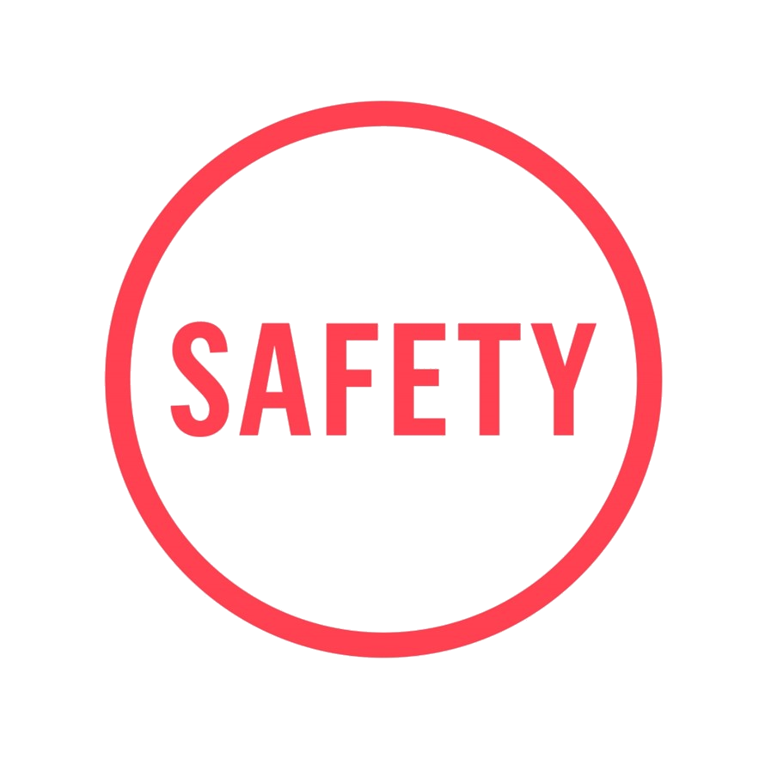
Lesson Learnt: Burns & scalds from takeaway coffee cups
Actions Taken / Recommended
Action 1: Ensure all staff involved with beverage service are trained on STC 25 Hot Beverage Service and this is documented on their Workplace Safety Management System Training Record Cards
Action 2: Ensure staff are trained to carry out visual checks that the lids have been placed on securely across 360̊
Action 3: Do not over fill cups – check whether the customer will be adding milk
Action 3: In self-service areas for adding milk/sugar, display signage reminding customers to securely fit the lid back onto the cup afterwards and that the contents will be hot
Action 4: Only use Compass approved disposable cups and lids
Action 5: Keep serving areas clear and tidy. Ensure the cup is placed onto a flat surface when placing the lid on
Action 6: Place the cup onto a flat surface to pass it to the customer – do not attempt to hand it over whilst holding it in the air
In Focus 🔍 There have been multiple incidents where burns and scalds have been sustained from the lid of a takeaway hot beverage cup not being securely in place Risk Assessment Potential Hazards: Burns, scalds and injury Slips, trips and falls Sprains/strains/brakes RIDDOR reportable injuries Risk Levels: Medium and High risk Consequences of Getting it Wrong: Scalds, burns or injury to: Members of the public including children and vulnerable people Customers CH&CO team and agency workers Civil Claims Permanent scarring and long-term medical treatment / physio for serious burns Slips, trips or falls in areas where spillages have occurred: Potential for sprains/strains/breaks RIDDOR reportable incidents | Root Cause / Contributing Factors Human error - team members not following procedures, lids not provided or not properly placed on the cup Incorrect lid size / brand / type used for the cup Lid split or damaged during lid application Customer / user error if the lid has been removed to add milk or sugar after being handed the drink Poor service flow in the area allowing the potential for customers to bump into each other Not following process Lack of staff training/new staff induction training before commencing role requirements Routine activity without thought
A Starbucks customer in the US was awarded $50m in damages after sustaining life altering burns and scalds from take away hot drinks spilling whilst at a drive-through.
Preventative Measures / Best Practices
Always put a lid on takeaway drinks A visual check is the best way of checking the lid is securely on the cup
Cardboard cup holders can assist customers with transporting multiple hot beverages. Cups must be securely placed deep into the cup holds.
The use of coffee cup clutches or sleeves can assist with making hot beverages easier to hold.
📣 Whistleblowing 📣
Worried about how things are being run at work? Call the Whistleblowing Hotline 0808 801 0351 (UK) 1800 910 351 (IRL)
Or email: assistance@hospitalityaction.org.uk

