Slide 1

Vacherin Monthly H&S Meeting
August 2025

Slide 2



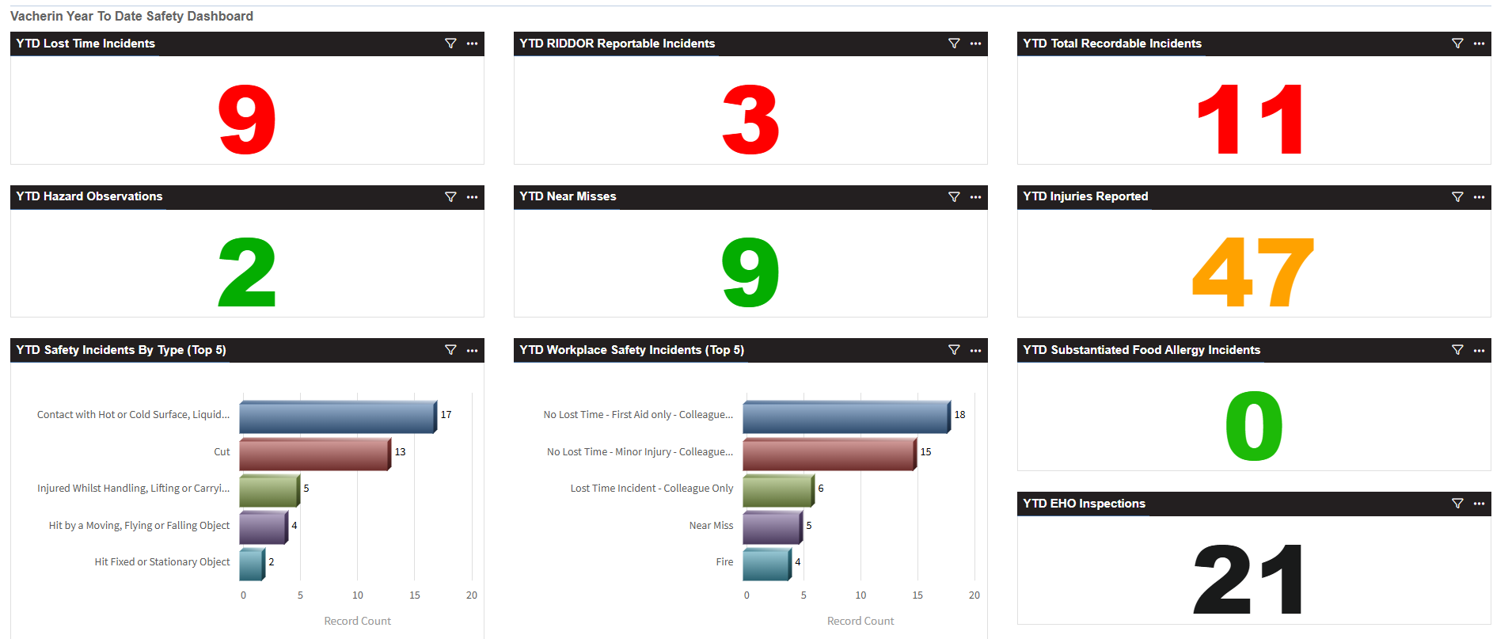
Vacherin Year to date stats

Slide 3




Vacherin July incidents summary
1 x Cut injury to head from walking into a metal gastro tray poking unsafely off a shelf
(Safe equipment storage)
1 x Cut injury to hand lifting the glass cold beverage dispenser by the tap and base, causing glass to break
(safe handling practices)
1 x Splinter injury from damaged wooden trolley
(Importance of work equipment inspection)
1 x Injury to hand from getting caught in between two doors
(Care and concentration on task)
2 x burn incident
1 from using coffee brewer, surplus water still remained in the top container
(Busy operation, rushing)
1 from using hot water boiler reportedly positioned quite high but unable to be moved/relocated
due to client restrictions
(Restrict use to certain individuals)
1 x Fire (non catering area)
(Bluetooth speaker left on charge overnight in a cupboard. Charging cable was PAT tested. The speaker was not. The speaker had a lithium battery)

Slide 4


Vacherin July incidents summary
3 x reported EHO visits for June 5 (2 received a FHR 5, 1 still awaiting score)
2 x Foreign body incidents
Ladybird in food
(Unsubstantiated – area where salad is served is open, uncovered)
Foreign body found in bought-in cheesecake
(Vendor assurance team assisting with investigation)
3 x Alleged food poisoning incidents
5 ill after consuming chicken salad at an event
1 ill 10 minutes after consuming smoked salmon – suggestion of scombroid poisoning
(Unsubstantiated – more common in tuna and mackerel subject to poor storage temperatures)
1 ill 45 minutes after consuming pork & salad
(Common theme, short onset time between consumption and illness)
1 x Food quality incident
(Discrepancies about allergen information provided from supplier for bought-in products)

Slide 5
Work equipment inspection register

Slide 6
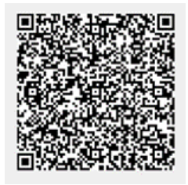

August See Care Share
In focus:
Continuous compliance:
Quarterly HSE reviews are now to be completed online
The QR code can be found at the front of new HACCP log books and
HSE website > Compliance > Continuous Improvement
82 questions down to 28 questions
Introduction of an annual GM HSE Self assessment to meet ISO requirements
Double click image for the PDF

Slide 7
HSE Updates
Food safety forms
Food service temperature record (hot holding and cold holding)
New prints of HACCP logbooks will look different
1st column is temperature of food as soon as it is placed on display
Cold holding temperatures are required every 3.5hrs
Hot holding temperatures are required every 90 minutes
The Pest Control Checklist has been updated

Slide 8
HSE Updates
Good hygiene practices & food safety conversations
GHP 11 Food Service & Display (now version 5), FSC 11
GHP 18 Food waste (now version 4), FSC 18
Double click images for the PDFs

Slide 9

HSE Updates
Workplace safety training videos
Designed to support teams using equipment safely
QR code stickers now available from Linney
They can be stuck on or close to equipment
Instructional videos which include information from the Safety Task Cards
Catering – Code: CO25_LAB_KIT_053927
Cleaning – Code: CO25_LAB_KIT_053928

Slide 10
Audits
Environmental / Sustainability questions
Q94. Has the site recorded food waste in Kg on The Source, Origami or Digitally?
Show us the dashboard of where data is inputted
Show us paper food waste records awaiting inputted
If unsure, seek guidance or advice from a member of the senior chef team about food waste recording
Q96. Are there dedicated food waste bins internally and separate food waste collections? Have macerators been decommissioned?
Dedicated food waste bins are available and in use
Compostable bags are used
Macerators are not used

Slide 11

Audits
Environmental/Sustainability questions
Q97. Waste is separated for recycling and correctly stored on site as per the country's legislative requirements?
England as of 31.03.25, see Simpler Recycling

Slide 12

Audits
Environmental/Sustainability questions
Q105. Controls are in place to store potentially hazardous substances on site
and manage spill risks?
Cooking oil & chemicals
Chemicals are stored safely and securely
“This means separate from food, equipment, sundries and PPE, in a lockable storeroom or cupboard. If a dedicated lockable storeroom or cupboard has not been made available for storage of products, then the room containing the storage area must be secure from unauthorized access when not occupied”
Waste oil is stored ideally outside of the kitchen
On a bund, sump or spill pallet which must
Sufficiently hold no less than 25% of the total storage capacity
Have watertight base and walls, no drainage valve
Be checked regularly for leaks, damage and accumulated rainwater
See GHP 18 Food Waste

Slide 13
Audits
Environmental/Sustainability questions
Q105. Controls are in place to store potentially hazardous substances on site and manage spill risks?
A spill kit should be available
A suitable spill kit may already be available - check with client / FM
Order Spill Kits from Manutan via Foodbuy Online.
To view their range visit https://www.manutan.co.uk/en/key/spill-containment#productBeginIndex:0&orderBy:7&
Order waste oil lockable storage is also available from Manutan
products codes A350094 and A350690

Slide 14
Audits
Environmental/Sustainability questions
Q105. Controls are in place to store potentially hazardous substances on site and manage spill risks?
                The Immediate Spill Response Plan has been completed
                (This forms part of the Environmental Tool Kit which is
                Q93 on the audit)

Slide 15
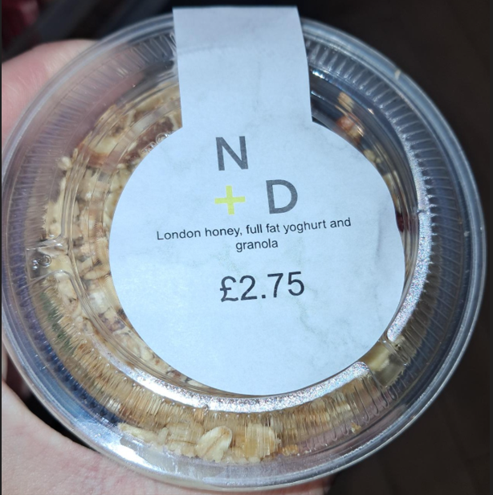
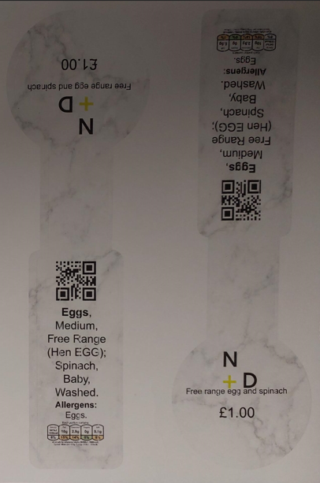
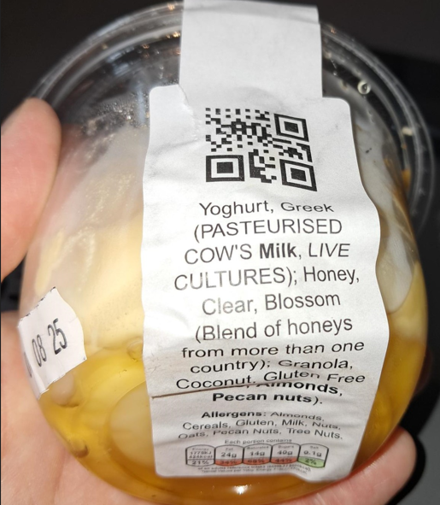
Audits
PPDS labels
Reminder that sites should be generating and printing their PPDS labels from
the Source. This is a Compass requirement to ensure PPDS labels used meet legal requirements
See GHP 21 Natasha’s Law for details

Slide 16
HSE Update
Closing actions on Air3 from audits and site visits
Report date | Vacherin closed | Vacherin in progress | Vacherin open | % closed
10.07.25 | 749 | 62 | 545 | 55%
24.07.25 | 809 | 67 | 504 | 58%
07.08.25 | 870 | 65 | 522 | 59%

Slide 17
Contact from Aug 2025
HSE Team contact
hse@compass-group.co.uk
Out of hours: Duty HSE Manager contact details available here: https://www.mycompasshse.co.uk/contacts/out-of-hours-hse-contact/
Jenny Todd - Head of QHSE for CH&CO
07770704451 jennifer.todd@compass-group.co.uk
Claire Grundy - HSE Manager (Company of Cooks)
07435175847 claire.grundy@chandcogroup.com
Maz Yung - HSE Manager (Gather & Gather, Blue Apple)
07435632000 Marianne.yung@chandcogroup.com

Slide 18
Q&A
Any questions?

