Slide 1

Company of Cooks
HSE Update
January 2025

Slide 2
January Company of Cooks Dashboard
1 near miss reported in January
RCP Liverpool 9th Jan – self closer fell off top of the door
2 EHO visits
ROH 17th Jan – 5*
Create Base CPU 21st Jan - 5* revisit from 3* in 2024
1 lost time injury & Injuries reported
ROH - crushed hand

Slide 3
FSA audits for January 2025

Slide 4
FSA Audits G&G Stadia

Slide 5
FSA audit actions still open 23-24 & 24-25

Slide 6
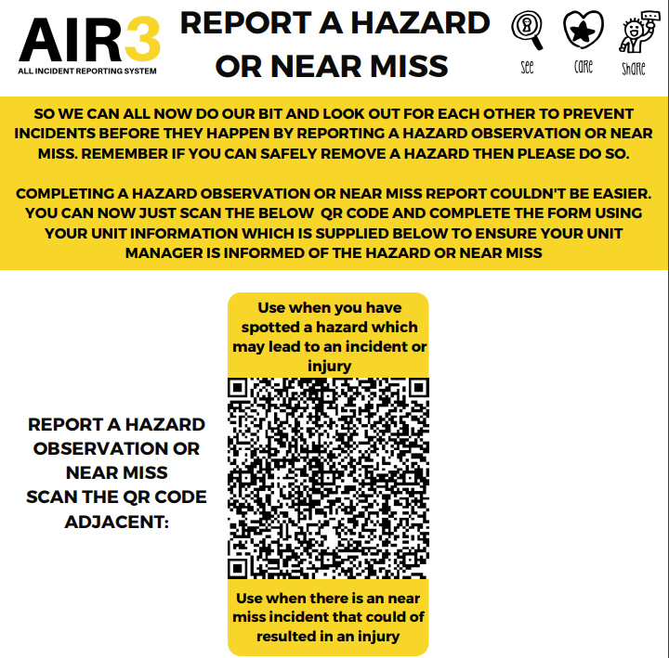
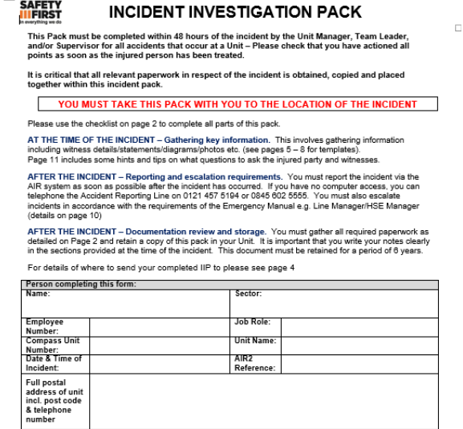
Accidents & Near Miss Reporting
Reporting near miss incidents may prevent future accidents occurring, resulting in injury, poster available for quick reporting
Incident Investigation Packs for EVERY injury incident logged. Page 2 details of what to be attached to Air3
HSE Central Compass team will follow up later once investigations closed
Training Videos available on my learning as well as PDFs on how to complete the IIP and other training tools in HSE Sharepoint

Slide 7



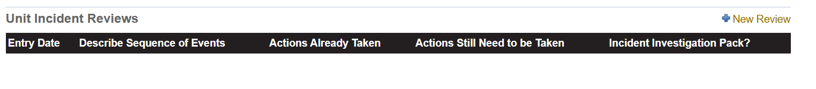
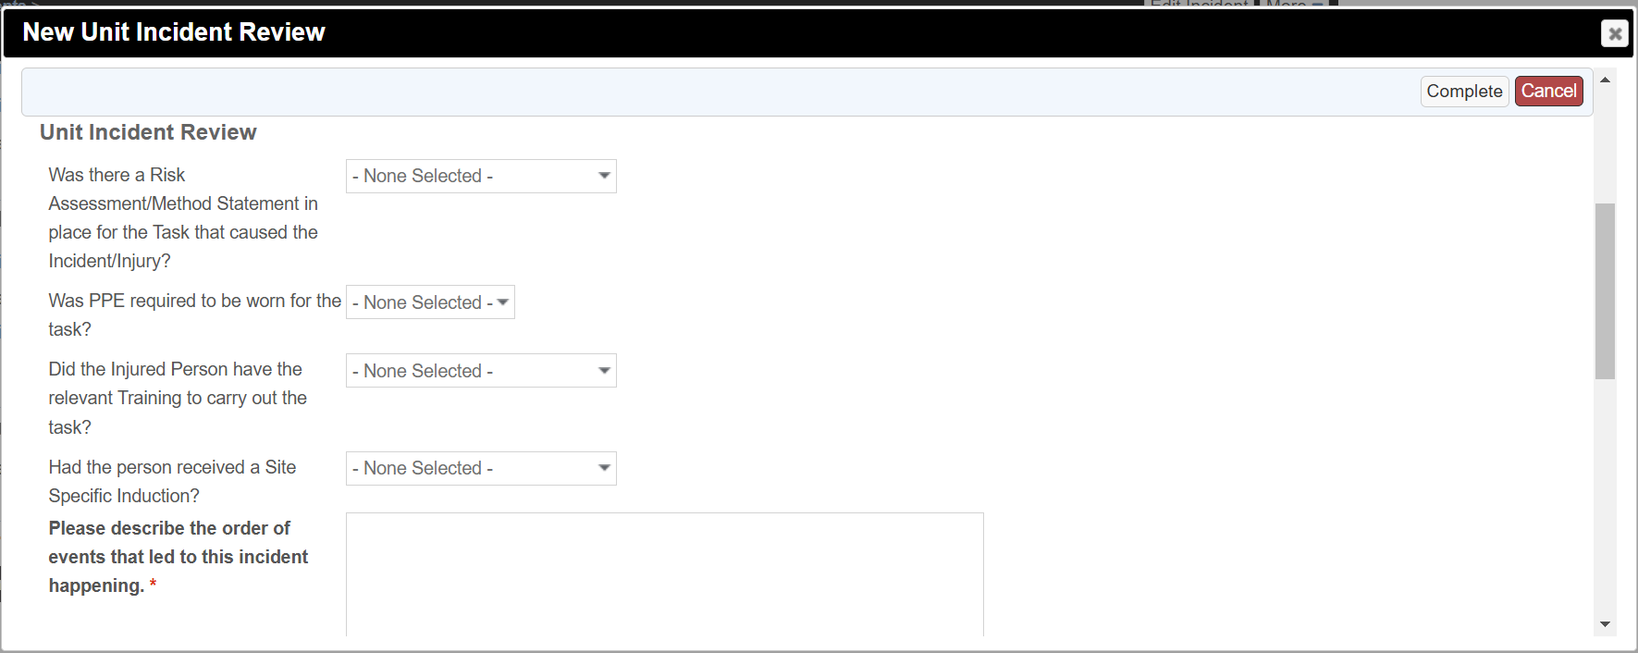
Attaching an incident investigation pack
Navigate to the bottom of the incident to ‘Unit Incident Reviews’ and click ‘+ New Review’
This will load a new window with some additional questions

Slide 8
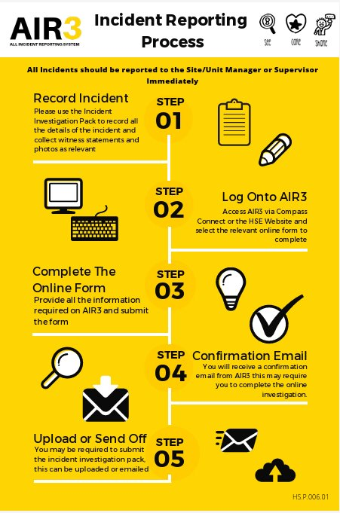
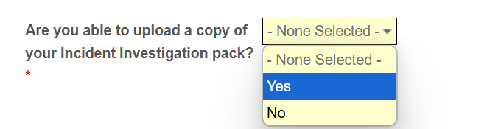
Attaching an incident investigation pack
For the last question ‘Are you able to upload a copy of your Incident Investigation Pack’ select yes, and attach as instructed

Slide 9
Specialist Foods (High risk processes)
GHP 25 Specialist Foods
Section A =Pickles, chutneys, jams, gels and syrups, flavoured oils, Yoghurt and Labneh,
Section B= Fermentation, Raw and semi-raw fish and fishery products, Sushi and sashimi, Dry-cure fish, Fish and fishery product tartar and carpaccio, Ceviche and soused fish, Oysters and other molluscs, Beef and venison tartar and carpaccio
Process (Search under Food Safety, GHP Guides, listed as number 25)
Contact HSE team
State the process you would like to add to the FSMS
Names of executive or head chefs
Evidence of food safety level 3 training

Slide 10
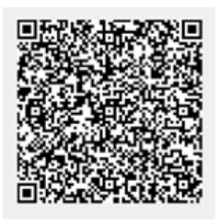
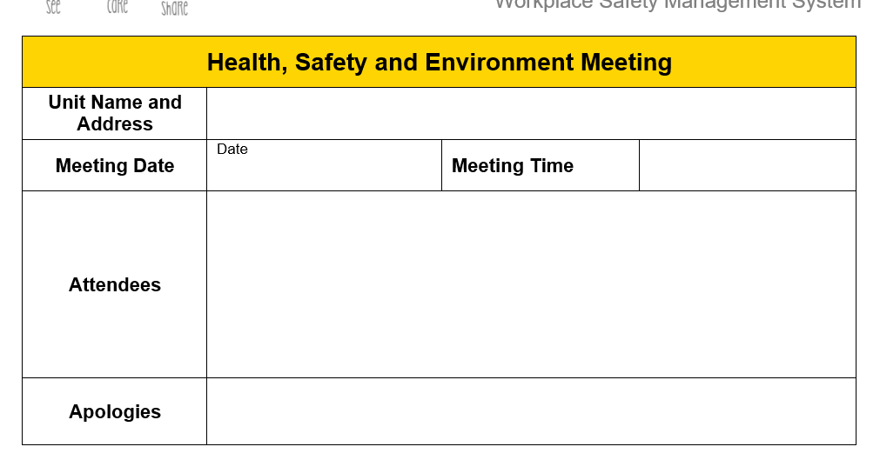
Internal audits
HSE quarterly record in HACCP log book will be moving onto on Air3 (only CH&Co unit to complete this online so far is BMA but with actions still open on it)
Under Compliance, Continuous improvement on Sharepoint or QR code in emergency book on NB
HSE meeting minutes
Allergens Risk Assessment also going on-line in 2025 - comms to come

Slide 11
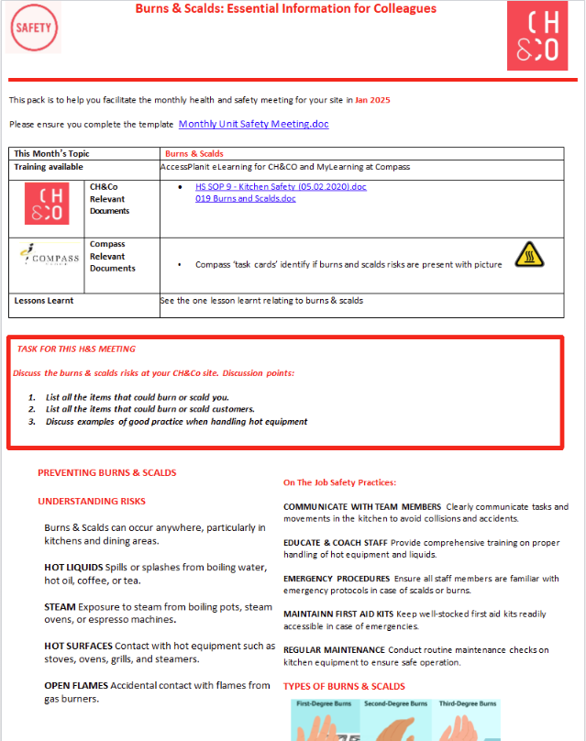
H&S meeting packs
To be used as part of monthly meeting agenda
2025 topics:
January Burns & Scalds,
February Manual Handling
https://chco.sharepoint.com/sites/CHCOHSE/Shared%20Documents/H%26S%20Monthly%20Support%20Packs?csf=1&web=1&e=qfgKjo

Slide 12
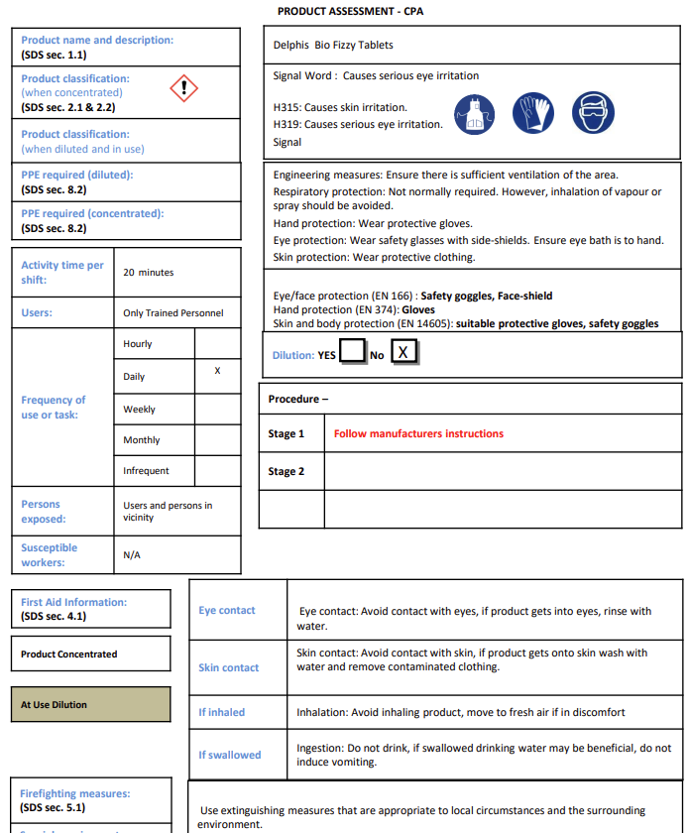

Chemical documents
Workplace Safety for Ecolab, Diversey and Coffee machine, rational oven, salt, Hannah wipes etc under COSHH other chemicals
Delphis and Biovate & EcoVate under sector HSE, CH&Co, chemicals
Ecolab is preferred supplier for Compass

Slide 13
Contacts
hseteam@chandcogroup.com – still use for tickets, queries, help etc
hse@compass-group.co.uk – for Origami issues
Out of hours emergencies – click on out of hours on sharepoint and a name and number of HSE team will be there who is covering. CH&Co and Compass team or O118 207 7583 will be directed to this person too

