Slide 1

SEE CARE SHARE
Management Coaching
2026
Version-7

Slide 2
AGENDA
1
2
3
4
5
6
7
8
9
10
Understanding Why
What is Safety Culture
How Can We Affect Change
The Impact of a Good Leader
Walking Past Sets The Standard
Leaders Safety Behaviours
Safety Walks
Your See Care Share Plan
Your Role
What Next

Slide 3

Notes:
Click to play video from Dave Crowe – HSE Director South

Slide 4

UNDERSTANDING WHY
Notes:
Click to play video about the Golden Circle of Why

Slide 5
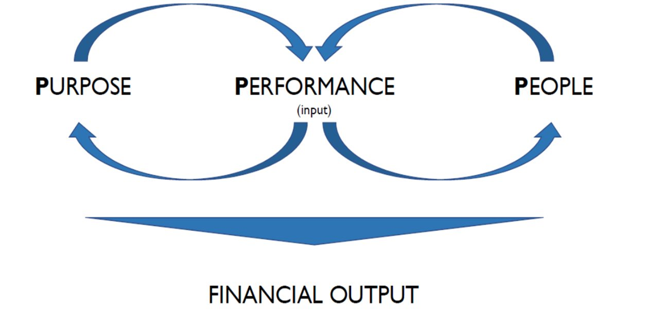
UNDERSTANDING WHY
WHAT
HOW
WHY
Notes:
Showing the diagram of the Golden Circle of why
Ask the question – Why do you think Compass does what we do? (remember it is not solely for finical gain, that is the output not the why)
Now we know the why behind Compass and putting it into perspective for safety, why are you safe at work?
The golden circle of why links into the Compass 3P’s nicely - 3 P’s (Compass Group Framework)
Why = Purpose, How = People, What = Performance
Remember the response to this question will vary from person to person – There is not a wrong answer, but you may need to remind people that it may be deeper then to earn money, what are they going to be doing with that money, that is their why!

Slide 6
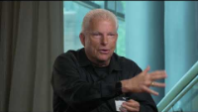
WHY SHOULD WE BE SAFE?
Notes:
In our day to day lives we can sometime become complacent to the hazards around us or start taking shortcuts, we are going to watch a brief video from Charlie Morecroft who shares his story as to why safety is important. Charlie is Motivational Safety Speaker who suffered life altering injuries whilst working at an Exxon refinery in New Jersey, USA. The result was over 5 years in and out hospital and over 50% of his body burnt – More info available on his website.
*Click to play the video
This video reminds me why what we are doing to introduce See Care Share is so important – it is so none of our team members have to experience a life altering injury at work.

Slide 7

The Du Point Bradely Curve

Slide 8
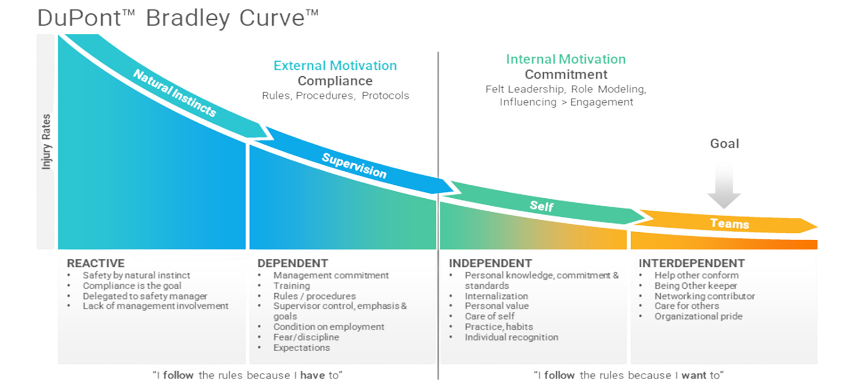
WHAT IS SAFETY CULTURE?
Safety culture is often described as assumptions, values, attitudes and behaviours related to safety, which are shared by a group of people within a business or an organisation.
Notes:
Safety Culture
Before clicking - Ask: What is Safety Culture? – click to show the definition.
Click to show the Du Point Bradely Curve and discuss each of the stages of the curve as described in the short video (https://www.youtube.com/watch?v=kjAqdWrvYLE)
Ask: Where do you think Compass are on the curve?
Ask: Do you think your unit is in a different stage on the curve?
Content
Ask: Knowing what we now know about the “why” what do you think we can do to affect change in our culture?
Ask: Who Sets the culture in your workplace?
After any discussion summarise the points discussed

Slide 9
HOW CAN WE AFFECT CHANGE?
If we want to have an impact, we need a shift
•From compliance to setting the standard
•From being in a comfort zone to question the status quo
•From training to coaching on the job
•From executing a task to being an example
•From negative to positive communication
Notes:
Click to reveal each of the points and discuss what they mean:
From compliance to setting the standard
Rather then focusing on doing the compliance to get through, look to be an example, a centre for safety excellence where we are focused on setting the standard.
From being in a comfort zone to question the status quo
Don’t be afraid to challenge and ask questions when it comes to safety, if you are doing something because that is “how it has always been done” but you think it can be better / safer, highlight it.
From training to coaching on the job
We often train our team members once when they start working for us and then not again until 3-year refreshers are due, are we surprised that incidents happen? We should move to a coaching mindset, regular short training and on the job to keep safety and the correct processes front of mind.
From executing a task to being an example
Understanding that your team will be looking at you to set the example going forward and know that your behaviours will affect the behaviours of your team.
From negative to positive communication
Move away from focusing on the negatives of safety and look for opportunities for sharing positive safety messages to your teams.

Slide 10
HOW CAN WE AFFECT CHANGE?
Safety cultural change can become viral
• Cultural change can be viral if we give the example and leverage positive communication
• Be a “Navigator” and avoid the “By-stander” effect
• Speak with/to the heart and generate emotions
(e.g. use videos rather than words)
Notes:
Making safety cultural change viral - Click to reveal each of the points and discuss what they mean:
Cultural change can be viral if we give the example and leverage positive communication
Look for examples of the why safety is important in your team and use that as an opportunity to leverage positive safety communication
Be a “Navigator” and avoid the “By-stander” effect
Don’t stand by where safety is not being practiced, challenge unsafe behaviour within your unit. Lead the way with safety
Speak with/to the heart and generate emotions
Make safety personal to you and your team, look for ways to generate emotions and speak to the why of those around you

Slide 11
PSYCHOLOGICAL SAFETY
Four Stages of Psychological Safety
Feeling Included
Connection & Belonging
Safe to Learn
Learning & Growing
Safe to Contribute
Making a Difference
Safe to Challenge
Make Things Better
Notes:
Safety and inclusion are fundamentally linked, as true inclusion requires a foundation of psychological safety where individuals feel secure, valued, and respected enough to contribute fully without fear. This intersection ensures that all people, regardless of background or differences, can thrive, thereby boosting innovation, morale, and performance.
Psychological Safety as a Bedrock: Without safety, inclusion efforts often fail because individuals may hold back from fully engaging. A safe environment means being able to speak up, challenge, and be one's authentic self without fear of harassment or ridicule.
4 stages of psychological safety
Inclusion safety – basic human need to connect and belong at home, work or in social settings everyone wants to be accepted. Creates environment without fear of rejection, embarrassment or punishment, boosting confidence, resilience and independence
Learner Safety – basic human need to learn and grow and be engaged in all aspects of learning – asking questions, giving and receiving feedback, experimenting and even making mistakes.
Contributor safety – basic human need to contribute and make a difference in a safe environment using skills, energy and enthusiasm – empowerment
Challenger safety – basic human need to make things better and gives confidence to ask why and to suggest alternatives without fear of reprisal – allows creativity and innovation
Inclusion Improves Safety Outcomes: Inclusive safety practices ensure that safety systems protect everyone equally, which can lead to better compliance and fewer incidents, particularly when incorporating diverse, global perspectives.
Fostering Belonging: True inclusion goes beyond diversity hiring; it is about creating a sense of belonging where employees feel "seen, heard, and respected".

Slide 12
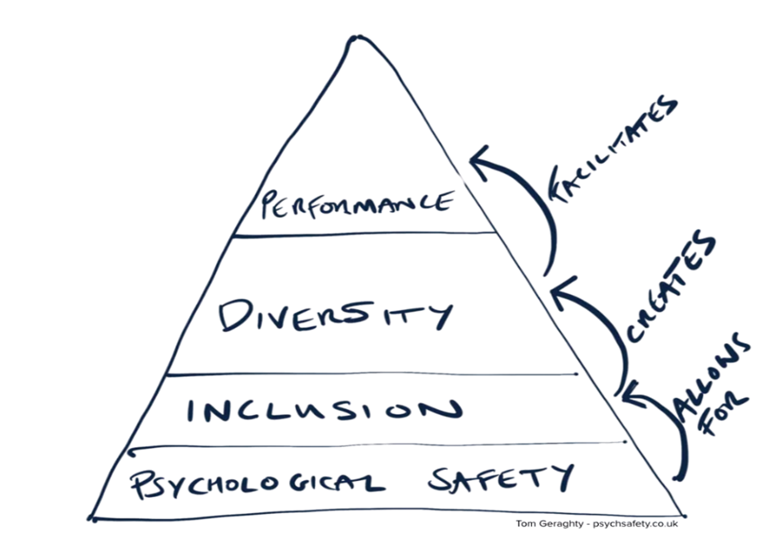
THE FOUNDATION FOR CREATION AND FACILITATION
Notes:
Talk through the pyramid and how psychological safety is the foundation for great performance.
Then lead into the next slide for the outputs and leadership actions.

Slide 13
Psychological Safety
Performance and Innovation
IMPACT
AND
ACTION
Employee Well-being
Retention and Morale
LEADERSHIP
Listen with Intent
Actively Cultivate Safety
Equitable Representation
Notes:
Safety and inclusion are fundamentally linked, as true inclusion requires a foundation of psychological safety where individuals feel secure, valued, and respected enough to contribute fully without fear. This intersection ensures that all people, regardless of background or differences, can thrive, thereby boosting innovation, morale, and performance.
Psychological Safety as a Bedrock: Without safety, inclusion efforts often fail because individuals may hold back from fully engaging. A safe environment means being able to speak up, challenge, and be one's authentic self without fear of harassment or ridicule.
4 stages of psychological safety
Inclusion safety – basic human need to connect and belong at home, work or in social settings everyone wants to be accepted. Creates environment without fear of rejection, embarrassment or punishment, boosting confidence, resilience and independence
Learner Safety – basic human need to learn and grow and be engaged in all aspects of learning – asking questions, giving and receiving feedback, experimenting and even making mistakes.
Contributor safety – basic human need to contribute and make a difference in a safe environment using skills, energy and enthusiasm – empowerment
Challenger safety – basic human need to make things better and gives confidence to ask why and to suggest alternatives without fear of reprisal – allows creativity and innovation
Inclusion Improves Safety Outcomes: Inclusive safety practices ensure that safety systems protect everyone equally, which can lead to better compliance and fewer incidents, particularly when incorporating diverse, global perspectives.
Fostering Belonging: True inclusion goes beyond diversity hiring; it is about creating a sense of belonging where employees feel "seen, heard, and respected".

Slide 14
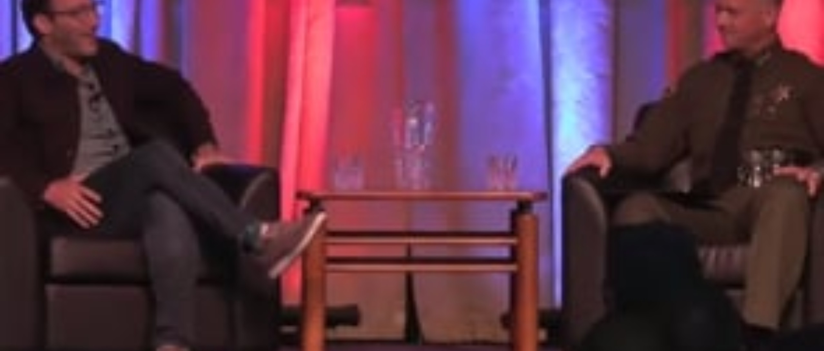
THE IMPACT OF A GOOD LEADER
Notes:
We are going to be watching another good video from Simon Sinek and this video is “Noah” and it is about the impact of a good leader. This video demonstrates how the behaviour of us mangers in the business will determine the behaviour of our teams, this is even true in our approach to safety.
*Click to play the video
Once the video has played summarise that wouldn’t we all want our teams to feeling like Noah at the Four Seasons and not Cesar’s Palace

Slide 15
NO COMPLACENCY
1.
2.
3.
Complacency is perhaps the biggest issues we face in completing our day-to-day tasks.
We are “used” to things being a certain way each time and this can affect many things such as productivity, quality and safety.
We no longer see risks associated with the job
Notes:
It then makes sense for us to focus on and improve proactive reporting, the more we identify risks the safer our people will be.
Give examples of normalising the environment, for example, a new starter enters a site kitchen and sees that the floor is wet they may be cautious when walking through it, they may do that over their next few shifts, eventually however they will fail to focus on the floor as the condition is now normal and they work in a normal manner without consideration of the wet floor. Our brain see’s this as habit or normal, it fills in the gaps which is fine whilst conditions are safe but could become very risky if conditions change in any way eg our wet floor also has some oil in it and becomes very slippery.
You can use other real life examples you may have encountered.
What elements or situations can lead to complacency in our work spaces?
Answers could be complacency, failing to identify and act on a hazard, normalising risk, lack of situational awareness, failure to fix infrastructure or equipment. This list is not exhaustive and may be expanded on.
Anchor this back to leadership - as leaders by walking past we set the standards for our sites and this combined with our people becoming complacent with the tasks that they complete on a daily basis, this could be a dangerous combination. By having conversations and prompting people in our walk throughs with keep the job top of mind and help to focus the teams.
Remember the lowest standard you set as a leader is the highest standard we can expect from our teams.

Slide 16
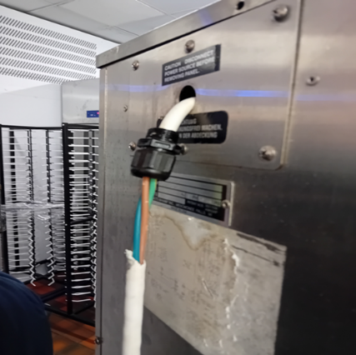
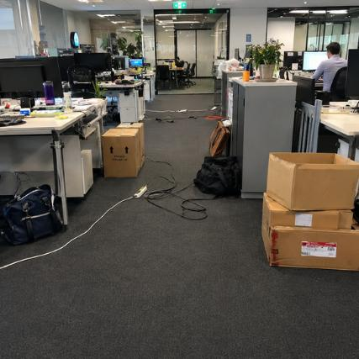
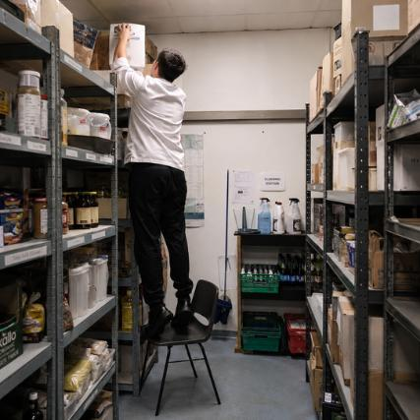

WALKING PAST SETS
THE STANDARD
Notes:
Key Point – Walking past sets the standards in life (home) and at work
Look closely at each of the photos whilst they may look amusing they are all displaying at-risk behaviour – some more obvious than others. You as a leader in the business need to be able to recognise at-risk behaviours with your teams but also within yourself – even at home. A positive safety culture is determined by what happens when no one is looking, for all of us this includes home.
Our teams should have situational awareness and be aware of at-risk behaviours and for that to happen we need to provide then feedback as well as be leading by example.
Let’s talk about for a moment on possibly the highest risk that you as an operations manager undertakes on a daily basis – that’s right driving. Driving whilst distracted is one of the biggest causes of road fatalities in the country. A new camera set up has shown that this is much more prevalent than first realised with people operating mobile phones below the window line. As Operations Managers we recognise that you will need to use the phone on occasion to make the best use of your time, I challenge you to think about if it as absolutely necessary to answer every single call or make every call you currently do whilst driving, is it really the best use of your time to be a distracted driver and put yourself and other drivers at risk? Your brain will focus on an image of the call that you are undertaking, this is an unconscious action. Think about why you want to be safe at work, think about going home to your family and friends at the end of the day in the same condition if not better and then think about all of your teams going home the same way.
Link that safety is not something that we switch off at the end of our workday it should be part of who we are our DNA.

Slide 17
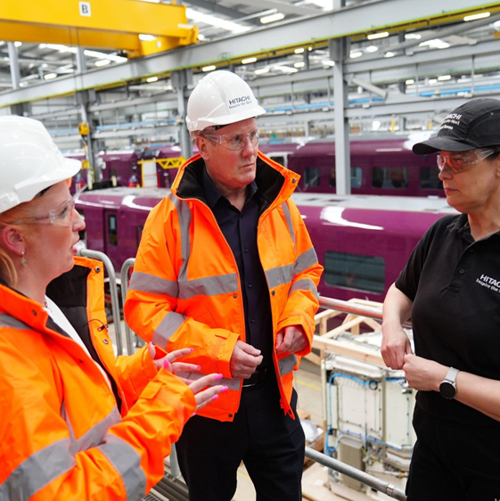
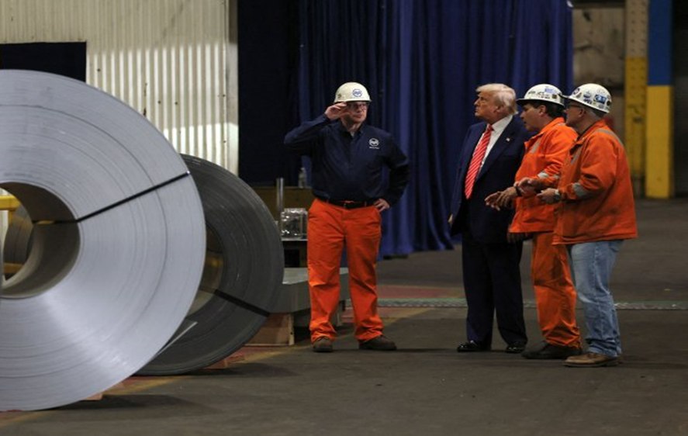
AS LEADERS WE SET THE STANDARD
Notes:
We now know and understand that our behaviour will affect the safety culture on a site. Looking at these images what does it say about these leaders?
What does this also say about the organisations leadership and their safety culture. If your CEO came into your unit and wanted to go into the kitchen without a white coat would you let them?

Slide 18
THE LOWEST STANDARD THAT YOU DEMONSTRATE AS A LEADER, IS THE HIGHEST STANDARD THAT YOU CAN EXPECT FROM YOUR TEAM.
Notes:
Read the quote on the screen
Emphasise to the team that the behaviour they demonstrate will affect the team – this is especially true when it come to their behaviour when it comes to safety.

Slide 19



OUR SAFETY BEHAVIOURS
COMMUNICATION
SPEAK OUT
This theme is all about encouraging positive two-way dialogue.
RISK ASSESSMENT
BE MINDFUL
This theme focuses on worksite hazards and how we control them.
INVOLVEMENT
GET INVOLVED
This theme is about being proactive to help keep safety front of mind.
Notes:
Highlight that to establish a good safety culture we need to have a framework of shared behaviours and in See Care Shaare these are made up of 3 Safety Behaviours, Speak Out, Be Mindful, Get Involved – in the following slides talk through each of the behaviours and what the Leaders behaviours look like.

Slide 20
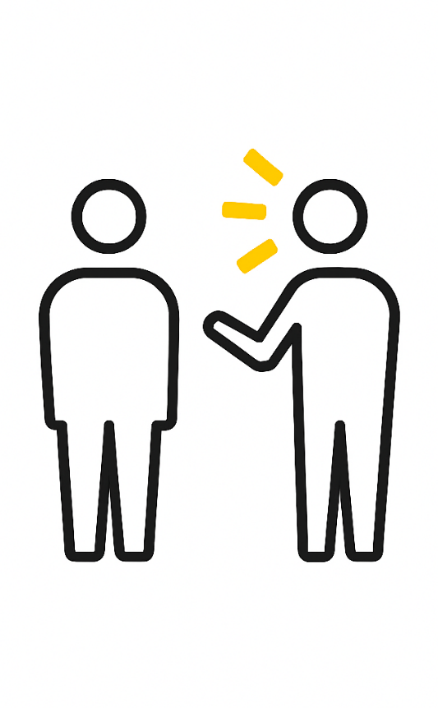
SPEAK OUT
  I will recognise and reward positive safety behaviour and performance and be visible on site engaging with individuals
  I will use the fair and just culture model to align an individual’s performance with a safe operation
  I will act on safety concerns immediately, seeking senior leadership or client support where necessary
  I will consult and involve the team in safety initiatives and problem solving
Notes:
Speak Out – remember this is about having positive two-way dialogue / conversations
Read through each of the behaviours on the screen, try linking to practical examples of this within the business

Slide 21

BE MINDFUL
  I will ensure that hazards are identified, risk assessments are conducted, and controls are put in place
  I will act on significant safety issues with the appropriate urgency and allow people to stop the job if they have safety concerns
  I will create a planned and organised environment for the team to work in
  I know my mindset impacts the way I behave, and will focus on having a zero-harm mindset
Notes:
Be Mindful – remember this is about being aware of our environment and the hazards present
Read through each of the behaviours on the screen, try linking to practical examples of this within the business

Slide 22

GET INVOLVED
  I will connect with individuals about why I believe safety is important and take the time to understand other’s beliefs about safety
  I will listen, act on, and provide timely, honest feedback on concerns raised
  I will demonstrate my commitment to safety through daily interactions and developing solutions, with the team, that improve the workplace
  I will coach and support team members to implement safety improvements together
Notes:
Get Involved – remember this is about being proactive and keeping safety a priority even when we are busy
Read through each of the behaviours on the screen, try linking to practical examples of this within the business

Slide 23
SAFETY WALKS
A key part of our See Care Share is Safety Walks, which are to be conducted by you, the leaders within our business. Any walk can be a safety walk!
Share - Step In
See - Be Present
Engage in Conversations
How are others today?
What will you do differently today?
Do we have everything we need to do the job?
Is anything different today?
Watch the behaviours of the team
Care - Be Authentic
How are you feeling today?
What is going well?
What can be done better?
How can we make that happen?
SAFETY WALKS ARE ABOUT
Having Courageous Conversations
Informal Safety Interactions
Being People Focused
Using Personal Stories
Using Prompters
Notes:
Safety walks are a vital part of the See Care Share programme, being seen and discussing safety with our teams shows our commitment to safety. There is a separate guide to safety walks which is available on the HSE Website (don’t worry we will go through this later).
Ask – What do you believe are the benefits to your units if you were carrying out regular safety walks?
Reinforce the elements in the table on the right i.e. See – Be Present​, Care – Be Authentic, ​Share – Step In​

Slide 24

TIME TO REFLECT
What are you going to change today?
What can you change in a week or a month?
How would this benefit your team?
How are you going to implement See Care Share in your unit?
Notes:
We are going to take 5mins – to give you the opportunity to complete your See Care Share Plan (this should have been available on the learning portal but you can share it to the Meeting Chat in Teams).
We would like them to take time to focus on the following points –
What are you going to change today – 1 week – 1 month?
How are you going to introduce See Care Share in your unit?
Click play to play the video which plays zen music for 5mins

Slide 25



YOUR ROLE
Notes:
Their role as managers and leaders in the business is to *Click to reveal the photos
To be an inspiring leader and promote the positive safety culture
Conduct the orchestra, your teams and make them play the best music as one – working as one
Create winning teams that go from strength to strength when it comes to both safety and the operation as a whole
**Click to move onto the next slide

Slide 26

“EVERY ACCOMPLISHMENT STARTS WITH THE DECISION TO TRY”
(John F. Kennedy)
Notes:
Say – “Every accomplishment starts with the decision to try”
Say – Remind everyone that all we can ask of them is to try, try to change the language that they use when talking about See Care Share and try implement in their units as best they can.

Slide 27

Notes:
Click to play video from Dave Crowe – HSE Director South

Slide 28
WHAT NEXT
Start today...
See
care
share
Change the language we use and aim for the leader that you would want to have
Plan your See Care Share Coaching for your team, as soon as possible
Make every walk a safety walk
Be Present​,
Be Authentic​,
Step In​ and Listen

Slide 29
RESOURCES
There are a range of resources available to download from the HSE Website
FRONTLINE COACHING
PRESENTATION
MONTHLY
SEE CARE SHARE
UPDATE
AWARENESS
POSTERS
FACILITATOR
NOTES
&
CERTIFICATES
SAFETY
WALK GUIDE

Slide 30

RESOURCES
Notes:
Click to play video showing how to find the See Care Share Resources

Slide 31
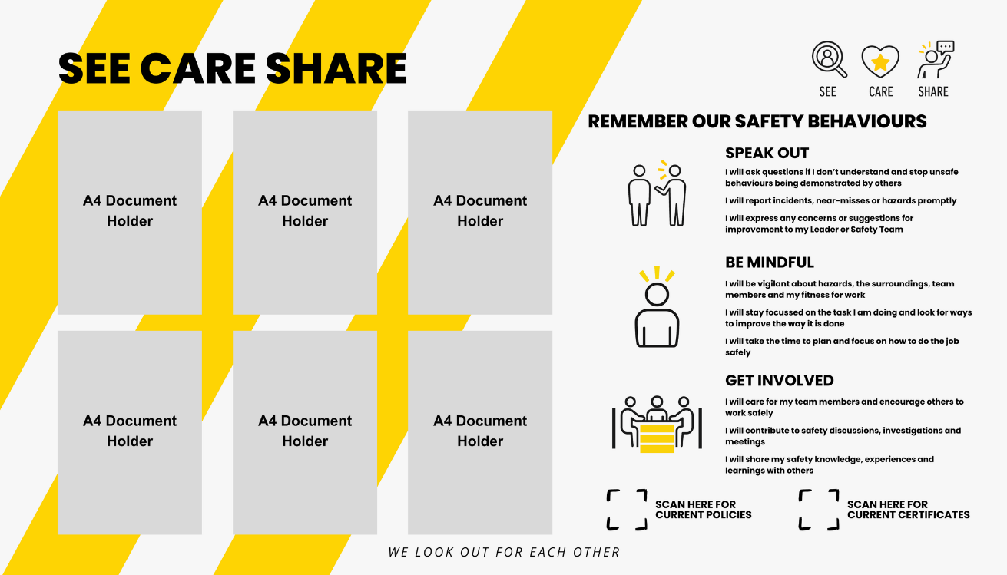
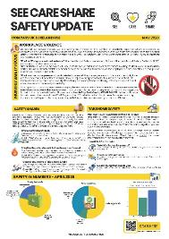
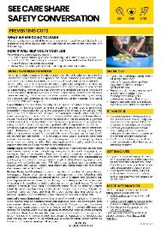
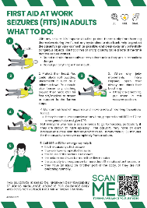



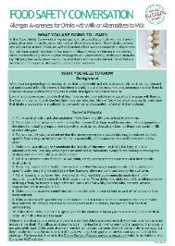
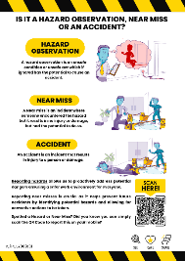
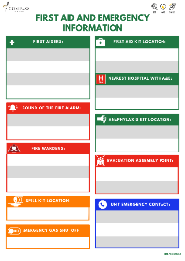
SEE CARE SHARE BOARD
Available to Order from Linney My Store:
Code: CO25_SIG_MISC_053933
Notes:
See Care Share Boards are available to order from Linney

Slide 32
FRONTLINE COACHING
There are a range of resources available to download from the HSE Website
Training Presentation
Delivery Tips
This Includes:
  Start With Why?
  What Is Safety Culture
  What Is Important to You (Breakout)
  Everyone Safety Behaviours
  Safety Walks
  What Can Change Today (Breakout)
  Thank you Message (Video)
  Deliver the best way for your team!
  Look to make it engaging
  Have a Safety Champion? – Use them!
  Make it yours and lead the way!
  Record it – Attendance and Completion
  Share It! – Take photos and share on Workjam

Slide 33


See Care Share - Management Coaching
Notes:
Let team members know that they will receive their certificates in the next 48hrs.

