Slide 1

Vacherin Monthly H&S Meeting
May 2025

Slide 2



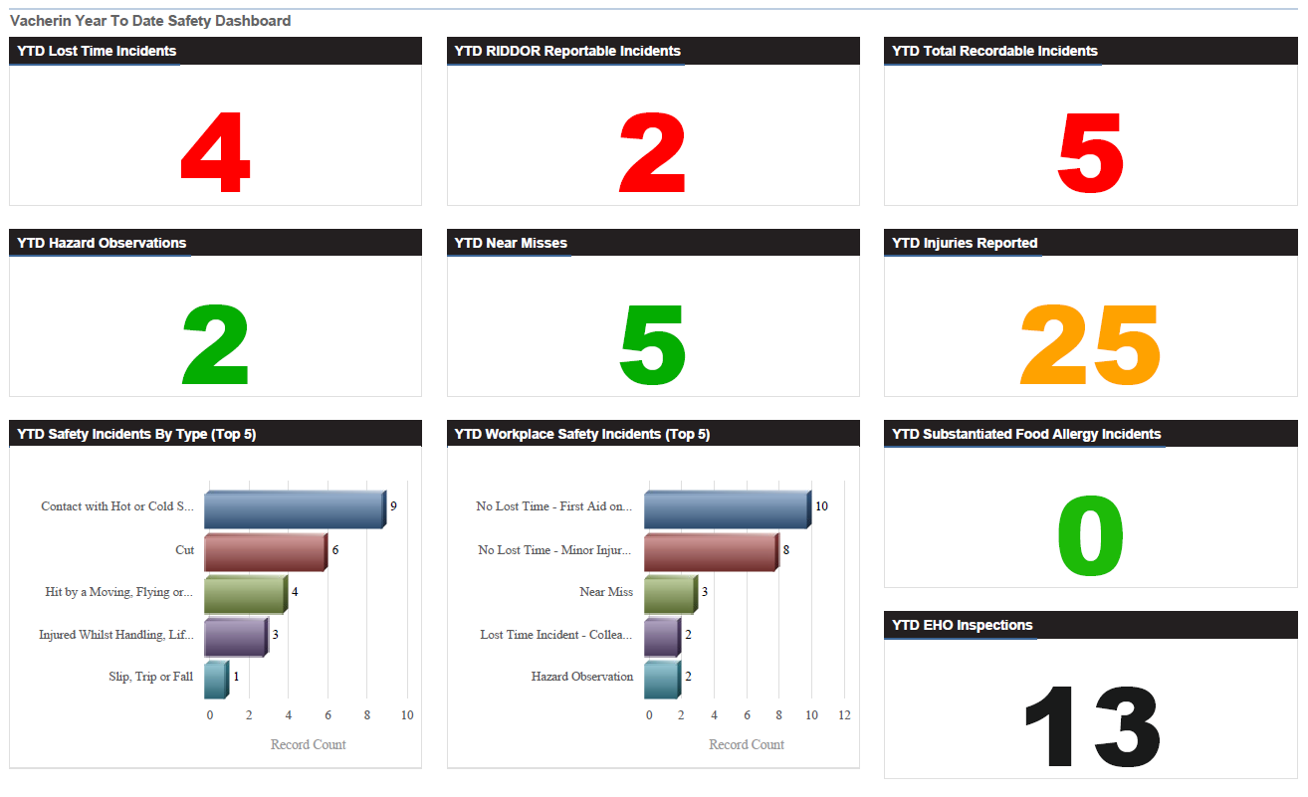
Vacherin Year to date stats

Slide 3




Vacherin April incidents summary
2 x hazardous observations and 1 x near miss reported in April
(Included an overfull cupboard in shared area, broken glass in the vicinity of
open food, liquid in contact with electrical)
3 x burn incidents (waffle machine, soup kettle, stove top)
1 x cut incident (bread knife)
1 x fall incident (irregular flooring)
5 x reported EHO visits for April
1 x Foreign body incident (plastic found in sauce)
1 x Alleged food poisoning (investigation concluded unsubstantiated)
1 x Allergen near miss (supplier product recall not received before the event)

Slide 4

May See Care Share
Double click images for the PDFs

Slide 5
May See Care Share
Double click images for the PDFs

Slide 6
Updated Good Hygiene Practices
GHP 04 Cross-Contamination
Clear guidance on labelling raw, cooked or ready-to-eat preparation areas
Requirements on areas used for both raw and RTE purposes
Requirements on labelling of equipment for raw and RTE purposes
Clearer instructions for 2 stage clean process
Wall and equipment stickers should have arrived with mobilisation kits or can be ordered from Linney

Slide 7
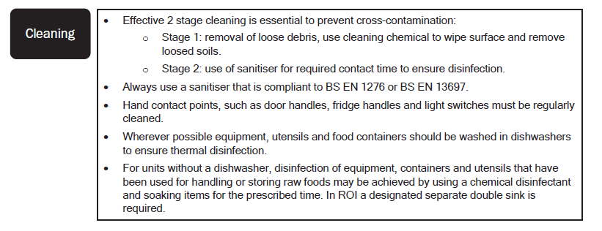
Two stage clean

Slide 8
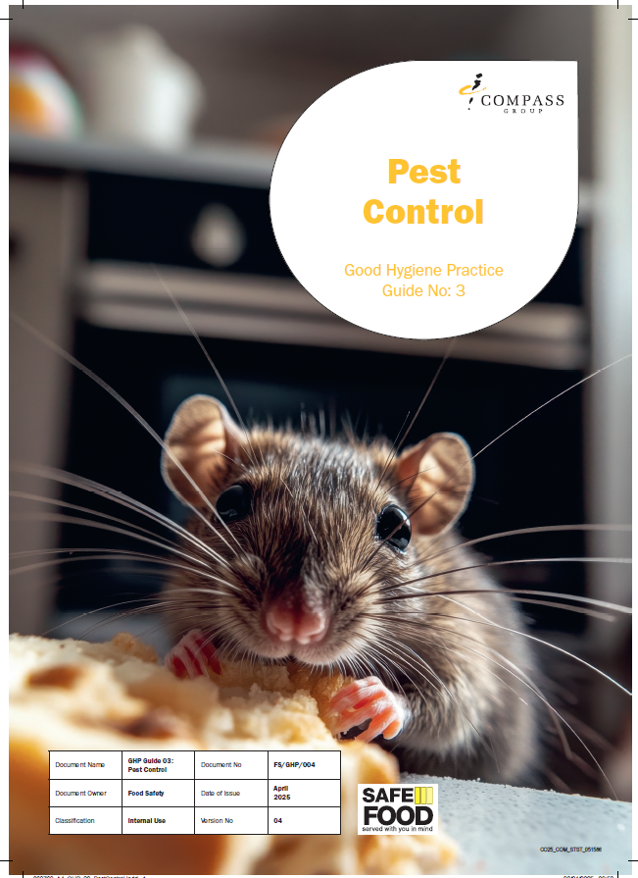
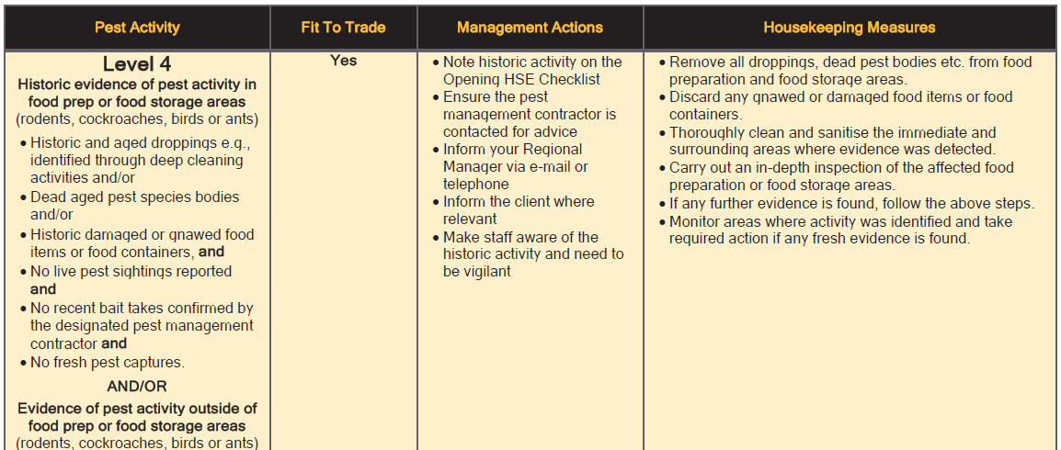
Updated Good Hygiene Practices
GHP 03 Pest Control
An extra level of controls required has been added for historic pest activity

Slide 9
Pest escalation process
- Audits now include a question about the catering team knowing the correct process in the event of pest activity
1. Inform the client immediately (where pest control is client managed)
2. Request a pest contractor visit ASAP to review issue and look for pest proofing opportunities
3. Refer to GHP 3 Pest Control to determine the level of activity and housekeeping measures required to be implemented straight away
4. Inform Ops and log on Air3 for HSE support
5. Complete the Pest Escalation Daily Checklist every day
6. Train team on how to looks for evidence of activity and sign off training
Ensure pest control reports are being shared with the catering team
Actions and recommendations on the report are being actioned

Slide 10
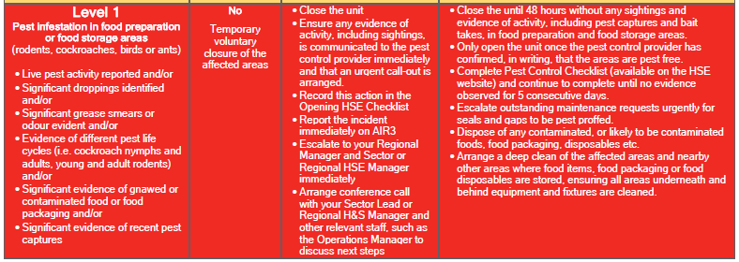
Pest escalation process
The Compass pest escalation process:
Live pest activity in food preparation or food storage areas
deems the catering operation not fit to trade,
temporary voluntary closure is required for 48 hours

Slide 11
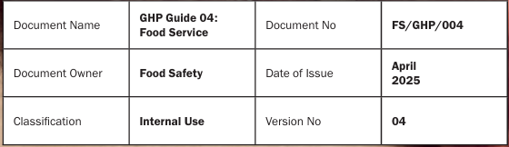
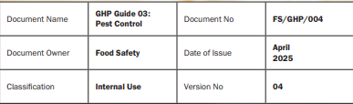
Please replace the versions of GHP 3 & GHP 4 you have in your
food safety management system folders
They are both now Version 4
Printed versions of the GHPs are available to order from Linney,
alternatively, you can print from HSE website and replace
Please brief you team members on the changes

Slide 12
Linney troubles?
compasssupport@linney.com

Slide 13
May audit tip!
Points available: 6
Q56. Are Chemical Safety Task Cards displayed in relevant locations where the chemicals are used?
Fully compliant 6 points
Some evidence of compliance -3 points
No evidence of compliance -15 points

Slide 14
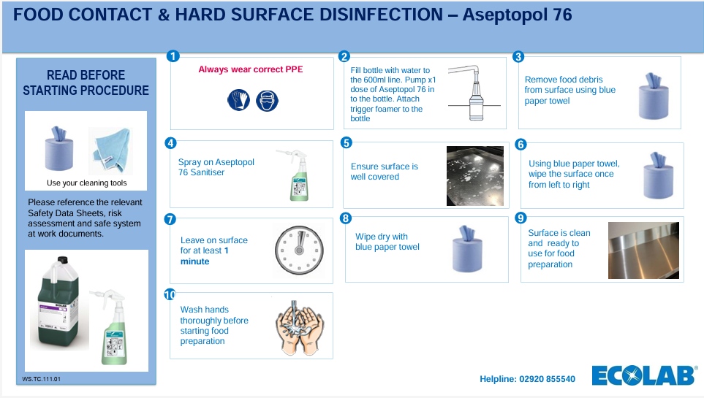
Requirements for COSHH Folders
A Compass COSHH product inventory at the front
A Compass COSHH assessment for each chemical
For any non-Ecolab chemicals, the COSHH Safety Data Sheet is also required
Safety Task Cards are required to be displayed for staff reference in the area the chemical is used

Slide 15





COSHH information
Workplace Safety section of the HSE website for
and Miscellaneous like Rationale and coffee machine chemicals
https://www.mycompasshse.co.uk/workplace-safety/chemical-safety-coshh/
Sector HSE > CH&CO > Chemical safety section of the HSE website for
https://www.mycompasshse.co.uk/sector-hse/chco/chemical-safety/

Slide 16




Changes to e-learning
For courses that are required to be renewed annually for refresher training such as food safety training
People will be sent a short competency test for these courses
It will take 5-10 minutes
If the competency test is passed this is all that is required
If failed, individuals will be reassigned the whole course required to re-do it

Slide 17

There is a dedicated page on the HSE website with details and resources
Falls on a Saturday this year but sites can promote this throughout the month

Slide 18
Things which should now be on Origami
Unit managers Quarterly H&S reviews
The Quarterly Review document is in the front of the log books but will be removed soon. You can access the link here to completed it on the computer or use the QR code to complete it on your phone
https://www.mycompasshse.co.uk/compliance/continuous-improvement/
Allergen risk assessment uploaded on an annual basis
All units were asked to upload a copy of their units Allergen Risk Assessment by 25th April
Use this link to access
Double click image for the PDF instructions on how to upload a copy of your Allergen Risk Assessment to Air3

Slide 19
Q&A
Any questions?

