Slide 1

Company Of Cooks
Monthly H&S Meeting
February 2025

Slide 2



EHO Visits
16th Kensington Palace 5*
20th Plaisterers Hall 5*
RIDDOR
4th – ROH with movable kitchen crushed hand
Near Misses
0 reported this month
Outstanding IIP packs
13th Goldsmiths Centre – burnt hand
3rd Olympia – walked into structure
February’s Dashboard
Notes:
Infrared thermometer calibrations - Thermometer Comparator must be used

Slide 3
Year to date Safety & Workplace safety Incident
Notes:
Infrared thermometer calibrations - Thermometer Comparator must be used

Slide 4
February Audits
Notes:
Infrared thermometer calibrations - Thermometer Comparator must be used

Slide 5
Outstanding Actions 23-24 & 24-25
Notes:
Infrared thermometer calibrations - Thermometer Comparator must be used

Slide 6

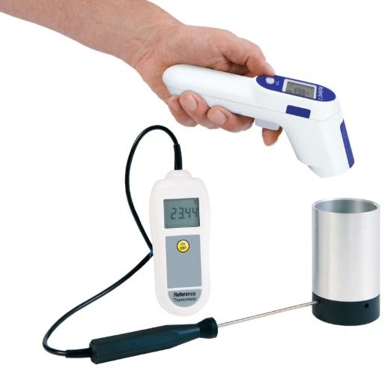
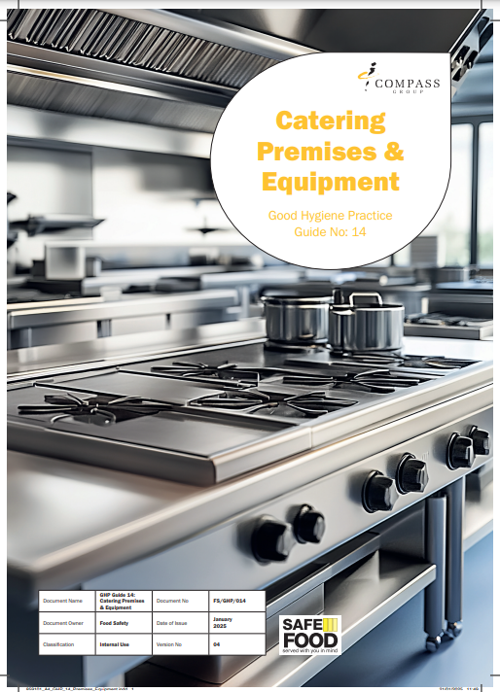
Compass GHP updates
Changes to GHP6 include:
Infrared thermometers can be used for delivery, fridge and freezer checks - reducing the amount of time required for temperature monitoring
Water bottles are acceptable as a food simulant
Changes to GHP14 include:
Minor wording tweaks
Please order new copies of both from Linney or copy from the HSE Compass page and replace them in your FSMS files after retraining the team
https://chco.sharepoint.com/NewsPages/GoodHygienePracticeFeb25-UKSITES.aspx
Notes:
Infrared thermometer calibrations - Thermometer Comparator must be used

Slide 7
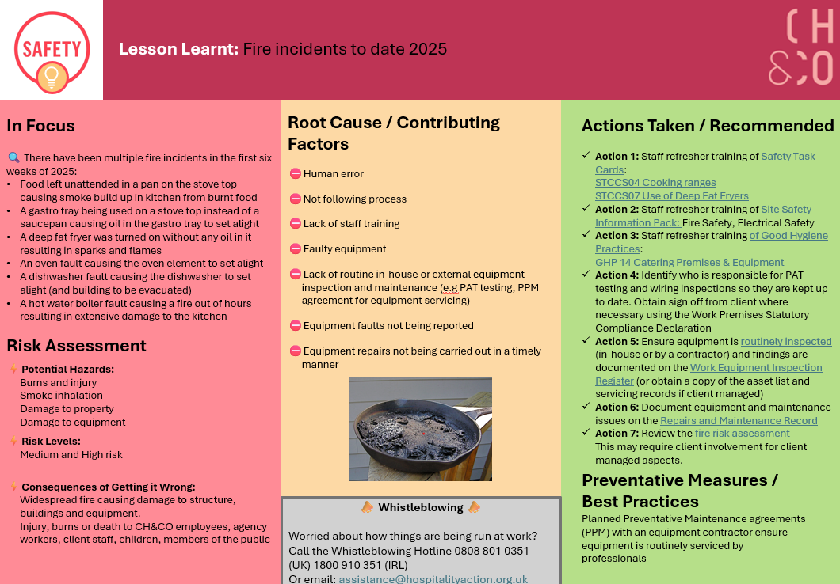
Fire
https://www.mycompasshse.co.uk/sector-hse/chco/lessons-learnt/

Slide 8
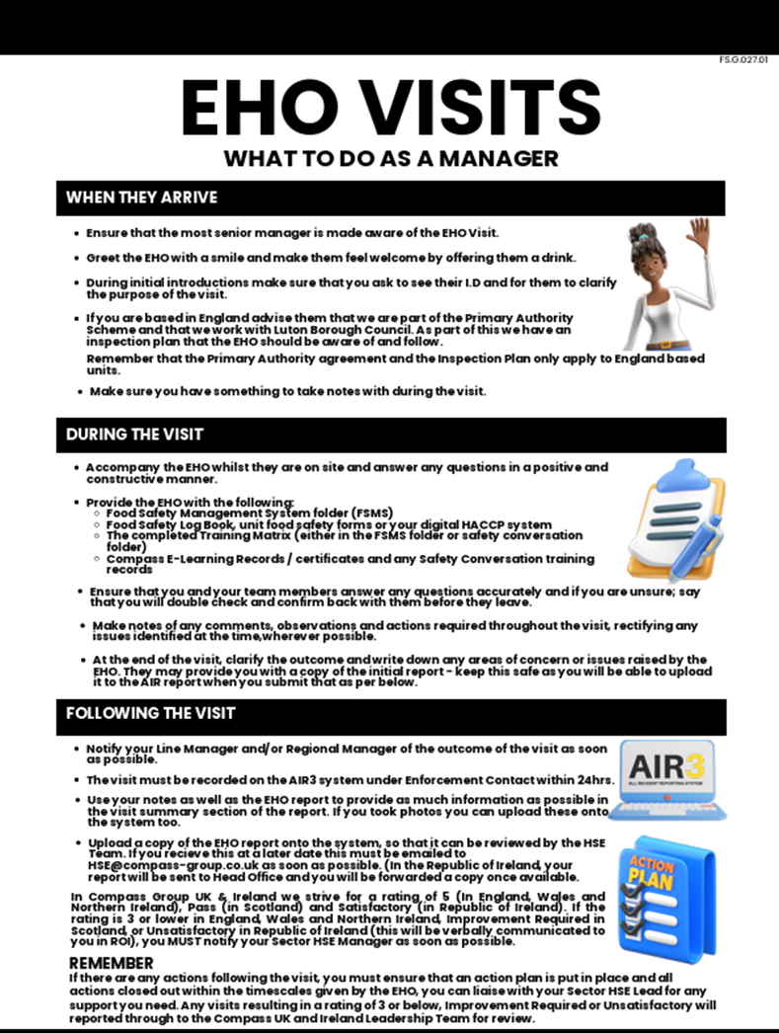
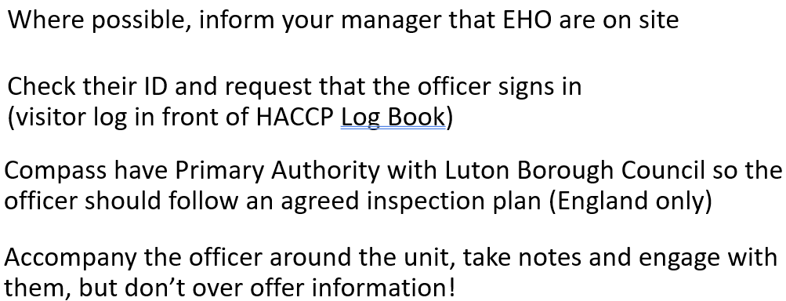
EHO visits
This guide is available here

Slide 9
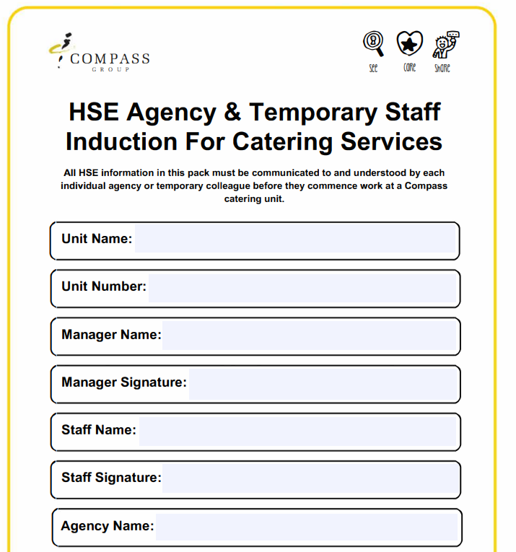
Agency workers
Complete agency sign off for any agency staff working onsite
Including Premier Crew workers
https://www.mycompasshse.co.uk/media/ftxgngjj/hse-agency-temporary-staff-induction-for-catering-services.pdf

Slide 10
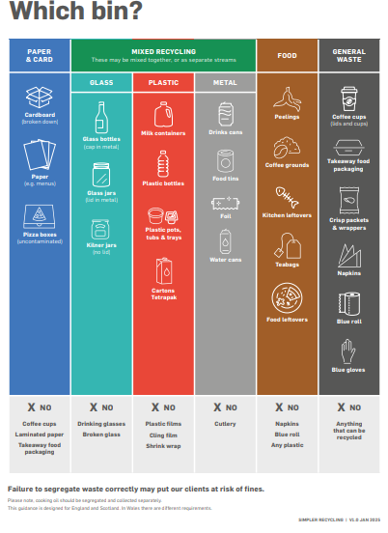
A New Simpler Recycling Scheme is coming to England
31st March 2025 food waste must be separated by law
Under the new regulations, we’ll need to sort waste
into four key categories:
Paper and Card
Recycling (Mixed or Segregated)
Food Waste
General Waste
It’s a legal requirement and we have a responsibility to follow it

Slide 11
A New Simpler Recycling Scheme is coming to England
https://chco.sharepoint.com/NewsPages/simpler_recycling_scheme_2025.aspx (Sharepoint announcement from 10th February)
Simpler Recycling Guide: Explains the changes and outlines what you need to do to comply.
Compliance Checker: A decision tree to help ensure your site is following the correct procedures.
Manager E-Learning: A short, 10-minute course for all managers in England (all relevant people will be auto-enrolled).
‘Which Bin?’ Poster: A handy reminder for back-of-house areas to guide staff on waste sorting.
‘How to Recycle’ E-Learning: Essential training on the ins and outs of recycling. Managers should assign this to their teams via the online training platform.
Craft and CAKE Training: A focused training session to teach how, where, and what to recycle effectively

Slide 12

Ops Audits are back!
The bi-annual ‘Ops manager’ audits are now available on Origami / AIR3.
For Company of Cooks, this should be completed by the site GM who typically looks after a group of units / kitchens on one site. Each unit / Kitchen will require an audit using the Ops Manager audit form.
The Ops manager audit needs to be completed twice per year using the Origami App, the first audit must be between now and the end of June and 2nd between July and December.
Actions need to be
Closed off on HSE
1/4ly on Origami
Reports will be on
this meeting to show
completion

Slide 13
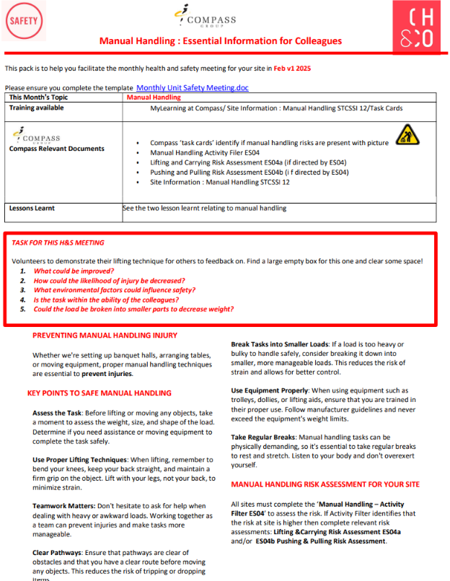
H&S meeting packs
To be used as part of monthly meeting agenda
Feb 2025 topic: Manual Handling
https://chco.sharepoint.com/sites/CHCOHSE/Shared%20Documents/H%26S%20Monthly%20Support%20Packs?csf=1&web=1&e=qfgKjo

Slide 14
Contacts
hseteam@chandcogroup.com
hse@compass-group.co.uk
Out of hours emergencies - https://www.mycompasshse.co.uk/news/out-of-hours-hse-contact-wc-06012025/

