Slide 1

SEE CARE SHARE
FRONTLINE Coaching
2026
Version-3
Notes:
Guidelines for a Successful Coaching Session
- Preparation for Display: If you're presenting on a large screen or using a projector, ensure everything is displayed prior to the start of the coaching session.
- Welcoming the Team: Begin by welcoming the team, encouraging their participation, and inviting them to enjoy the session.
- Housekeeping Details:
- Phones: Please make sure phones are turned off.
- Restroom Locations: Inform attendees about the locations of restrooms.
- Questions: Encourage participants to raise their hands for questions.
- Social Distancing: Remind everyone to maintain social distancing throughout the session.

Slide 2
AGENDA
1
2
3
4
5
6
7
8
9
Welcome Message - Video
Start With Why
Activity - Why Is Safety Important To You?
What Is Safety Culture?
Activity - What is Our Safety Culture?
Everyone Safety Behaviours
Safety Walks
Activity - What Can We Do Today To Improve Safety
Closing Message - Video
Notes:
Introduction to Our See Care Journey
This marks the beginning or a revitalization of our See Care Journey. To ensure that everyone is on the same page, we will go through some slides, watch a couple of video messages, and engage in two brief group activities.
Overview of the Session
- Review the slide headings to provide the team with an overview of what to anticipate.
- Click to advance to the next slide.

Slide 3

Notes:
Now, let's tune in for a short and snappy welcome message from the Compass HSE Team! – Please note that you need a internet connection to play the video.

Slide 4

START WITH WHY
Why do you come to work each day?
Who do you think is responsible for your safety at work and why?
Why is safety important to you?
Notes:
Engage with Questions from the Slide
Consider the following potential responses:
- To earn an income
- To support my family
- To fund my social activities or vacations
- Or simply because they find joy in their work
Emphasize this crucial point: no matter the motivation for coming to work, our sense of safety is paramount. We all share the responsibility for ensuring our own safety and that of those around us.

Slide 5
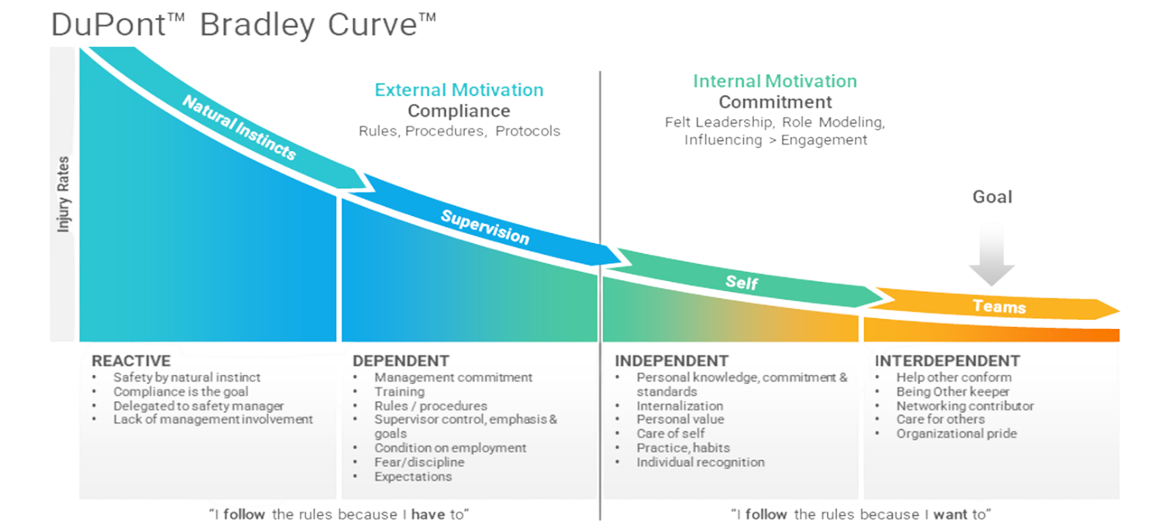
WHAT IS SAFETY CULTURE?
Safety culture is often described as assumptions, values, attitudes and behaviours related to safety, which are shared by a group of people within a business or an organisation.
Notes:
Safety Culture
Before proceeding:
- Ask: What is Safety Culture? – Click to reveal the definition.
- Click to display the DuPont Bradley Curve and discuss each stage as outlined in the brief video.
Content Discussion
- Ask: Considering what we've learned about the “why,” what actions do you think we can take to inspire change in our culture?
After any discussion, be sure to summarize the key points that were covered.

Slide 6
Do you think we have a good safety culture?
Reactive
Dependent
Independent
Interdependent
  Who sets the safety culture in our unit?
  Where do you think we are on the Bradley Curve?
  Why do you think we are there?
  What do we need to do to shift to the right and get to interdependent?
Notes:
Now, pose the questions displayed on the screen.
- Take note of where you believe we stand on the graph: Are we reactive, dependent, independent, or interdependent?
The primary takeaway from this activity is to help the team realize that they have the power to influence and alter their position.
Encourage them to start contemplating how they can shift the culture to benefit everyone involved.

Slide 7



OUR SAFETY BEHAVIOURS
COMMUNICATION
SPEAK OUT
This theme is all about encouraging positive two-way dialogue.
RISK ASSESSMENT
BE MINDFUL
This theme focuses on worksite hazards and how we control them.
INVOLVEMENT
GET INVOLVED
This theme is about being proactive to help keep safety front of mind.
Notes:
Fostering a Strong Safety Culture
To cultivate a robust safety culture, we must all operate within the same framework—this is where Safety Behaviours come into play. You may recognize some of these principles, but they have been revised to ensure that you are at the heart of our safety culture.
Key Behaviours:
- Speak Out: Encourages us to engage in positive, two-way dialogues and conversations.
- Be Mindful: Focuses on being aware of workplace hazards and understanding how we can manage them effectively.
- Get Involved: Inspires all of us to take a proactive approach to safety, keeping it at the forefront of our activities.
We will now take a brief look at each of these behaviours in greater detail.
*Click to reveal each behaviour.
**Click to move on to the next slide.

Slide 8
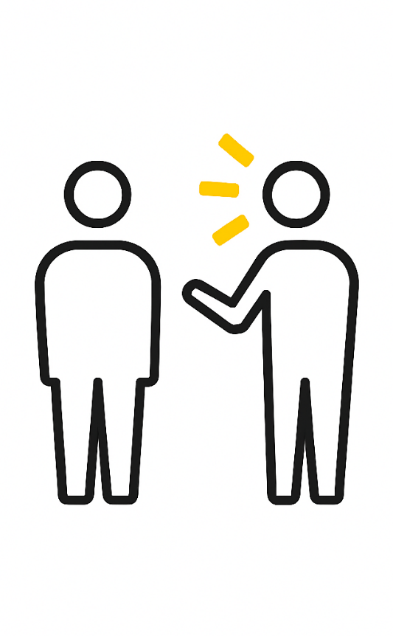
SPEAK OUT
  I will ask questions if I don’t understand and stop unsafe behaviours being demonstrated by others
  I will report incidents, near-misses or hazards promptly
  I will express any concerns or suggestions for improvement to my Supervisor and Line Manager
Notes:
Speak Out – remember this is about having positive two
way dialogue / conversations
Read through each of the behaviours on the screen, try
linking to practical examples of this in your unit
Encourage discussion about how this behaviour can be
demonstrated in your unit.
*Click to reveal each example (3 in total)
**Click to move onto the next slide

Slide 9

BE MINDFUL
  I will be vigilant about hazards, the surroundings, team members and my fitness for work
  I will stay focussed on the task I am doing and look for ways to improve the way it is done
  I will take the time to plan and focus on how to do the job safely
Notes:
Be Mindful – remember this is about being aware of our
environment and the hazards present
Read through each of the behaviours on the screen, try
linking to practical examples of this in your unit
Encourage discussion about how this behaviour can be
demonstrated in your unit.
*Click to reveal each example (3 in total)
**Click to move onto the next slide

Slide 10

GET INVOLVED
  I will care for my team members and encourage others to work safely
  I will contribute to safety discussions, investigations and meetings
  I will share my safety knowledge, experiences and learnings with others
Notes:
Get Involved – remember this is about being proactive
and keeping safety a priority even when we are busy
Read through each of the behaviours on the screen, try
linking to practical examples of this in your unit
Encourage discussion about how this behaviour can be
demonstrated in your unit.
*Click to reveal each example (3 in total)
**Click to move onto the next slide

Slide 11
SAFETY WALKS
A key part of our See Care Share is Safety Walks, which are to be conducted by the leaders within our business. Any walk can be a safety walk!
Share - Step In
See - Be Present
Engage in Conversations
How are others today?
What will you do differently today?
Do we have everything we need to do the job?
Is anything different today?
Watch the behaviours of the team
Care - Be Authentic
How are you feeling today?
What is going well?
What can be done better?
How can we make that happen?
These are not to catch anyone out, this is about being present and understanding what we can do differently to improve the business for everyone.
Notes:
Discuss the Slide's Content
The purpose of this slide is to engage your team in the Safety Walk process and encourage them to feel at ease speaking with ANY MANAGEMENT during a Safety Walk. Be sure to emphasize the actions they should take:
- Respond to questions openly and honestly
- Avoid shyness or hesitation
- Offer any valid suggestions or comments
Click to proceed to the next slide.

Slide 12

TIME TO REFLECT
What can we change today?
Let’s identify what we can...
Start
Continue
Stop
doing to improve our safety culture
Notes:
Organizing Team Discussions for Workplace Safety
- Divide the team into groups of 3 to 6 individuals. If the team is small, you can conduct this as a single group, but appoint someone to take the lead.
- Each group should discuss potential changes to enhance workplace safety. This could involve starting, stopping, or modifying a work process.
- Assign a leader in each group to take notes and provide feedback.
Keep the slide with the activity visible throughout the discussion and feedback session.
Click to proceed to the next slide.

Slide 13
LET’S START RIGHT NOW
  Check if there is anything that isn’t working, has it been reported?
  Look at the set up within your area, is it safe?
  Have you got and are you using the correct PPE?
  If the answer to any of these questions is no then you supervisor or manager know today.
Notes:
Let’s Start Today! (Remember you will set the tone!)
Read through the slide and add points that might be more
applicable to your unit.
*Click to move onto the next slide

Slide 14

“EVERY ACCOMPLISHMENT STARTS WITH THE DECISION TO TRY”
(John F. Kennedy)

Slide 15

Notes:
Now, let's tune in for a short and snappy welcome message from the Compass HSE Team! - Please note that you need an internet connection to play the video.

Slide 16


See Care Share - Frontline Coaching
Notes:
Thank the team and share why their safety is so important
to you as their leader – remember to make it personal.
Remind them that their See Care Share Journey has
started!

