Slide 1






Monthly HSE
Review
Oct 2026

Slide 2
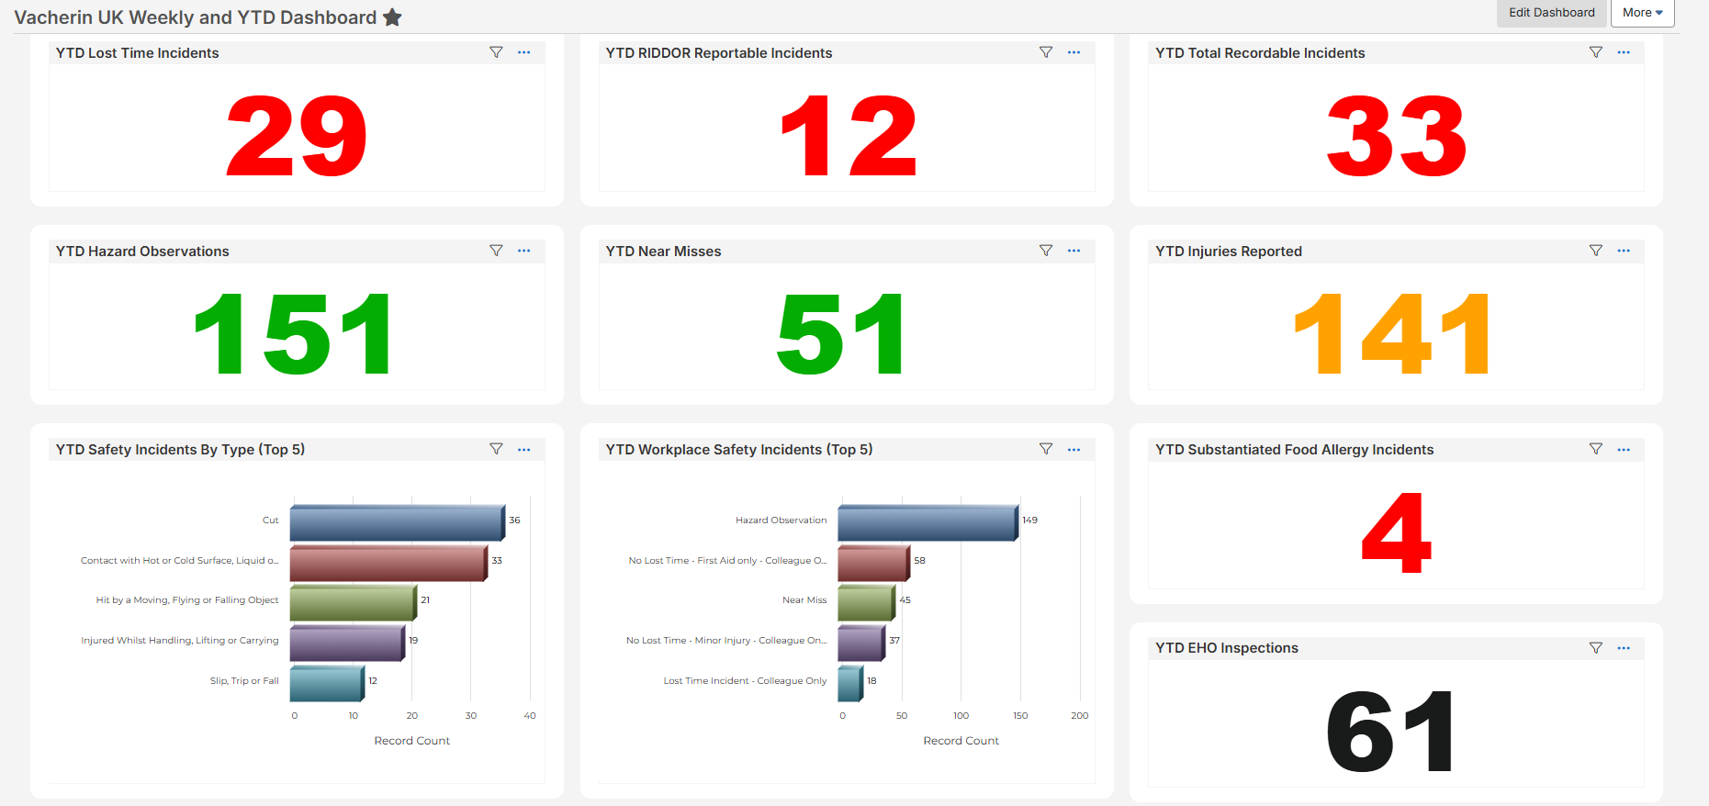
Vacherin YTD Overview

Slide 3


TRIFR & MFSIR – P12
P12 | CH&CO | G&G | G&G ROI | Vacherin | CH&CO Leisure
TRIFR | 10 | 3 | 2 | 4 | 1
MFSIR | 1 | 1 | 0 | 0 | 0
FSIR (FB+MFSIR) | 6 | 1 | 1 | 4 | 0
 | YTD CH&CO | YTD Target | EOY Target | G&G | G&G ROI | Vacherin | CH&CO Leisure
TRIFR | 71 | 59 | ≃59 | 27 | 10 | 25 | 9
MFSIR | 9 | 7 | ≃7 | 2 | 1 | 4 | 2
Safety Walks | 1520 | 1440 | 1440 | 937 | 106 | 227 | 250
Hazard Obs | 1559 |  |  | 1336 | 85 | 133 | 26
“TRIFR (Total Recordable Incident Frequency Rate) – Lost Time Incidents', Medical Treatment Cases, Restricted Workdays, Fatalities
MFSIR (Material Food Safety Incident Rate) - Substantiated allergen reaction, substantiated food poisonings”
FSIR (Food Safety Incident Rate) – Allergen reaction, in unit foreign bodies and in unit food poisonings
SEE CARE SHARE
WE LOOK OUT FOR EACH OTHER

Slide 4

Substantiated Allergic Reactions
9 in total for the 2025/2026 financial year
4 of which were within Vacherin sites
More details to follow separately
GHP 13 Allergens
Monthly allergen compliance audit
Please check out the lessons learnt page on the HSE website.
Lessons Learnt | Compass HSE
SEE CARE SHARE
WE LOOK OUT FOR EACH OTHER
Notes:
2 Burns - Hot liquids
Grilled lemon exploded causing oil to splash in a colleague's eye (LTI)
Spilt hot water on chest. Onsite first aid given.
1 Hit by Moving Object
Colleague dropped plates on another colleague's foot (LTI)
1 Slip and Trip
Colleague slipped on a wet floor on the way to the site toilets (non catering area)
2 Cuts
Colleague cut their hand on a sharp edge of shelving
Colleague cut their hand whilst cleaning a water dispenser
1 Contact with Chemicals
Chemical splashed in eye whilst mopping

Slide 5
Food Safety incidents overview
1 x Foreign body - worm in food (unsubstantiated)
2 x Foreign body - salad from suppliers containing bugs/insects (vendor assurance)
1 x Foreign body - egg shell inside a sandwich
1 x Alleged food poisoning after consuming a trout bagel (ongoing)
1 x Alleged allergic reaction (unsubstantiated) – Relating to a bought-in pre-packed sandwich
Health & Safety incidents overview
1 x Injury – First Aid Only – A tray placed on top of a fridge fell onto a chef’s head
1 x Injury – Lost time – A sign fell onto a catering colleague’s head
1 x Injury – Lost time – A slip in the pot wash area
1 x Injury – Restricted work duties – Cut from a glass
Please check out the lessons learnt page on the HSE website.
Lessons Learnt | Compass HSE
SEE CARE SHARE
WE LOOK OUT FOR EACH OTHER
Notes:
2 Burns - Hot liquids
Grilled lemon exploded causing oil to splash in a colleague's eye (LTI)
Spilt hot water on chest. Onsite first aid given.
1 Hit by Moving Object
Colleague dropped plates on another colleague's foot (LTI)
1 Slip and Trip
Colleague slipped on a wet floor on the way to the site toilets (non catering area)
2 Cuts
Colleague cut their hand on a sharp edge of shelving
Colleague cut their hand whilst cleaning a water dispenser
1 Contact with Chemicals
Chemical splashed in eye whilst mopping

Slide 6
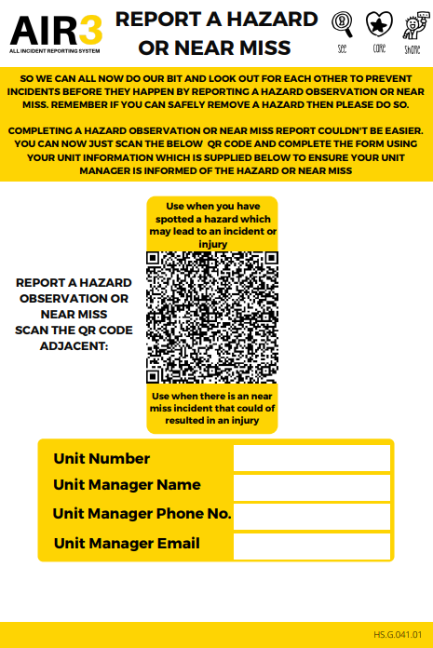

Hazard Observations and Near Misses YTD
Hazard Observations 151
Near Misses 51
The majority that get reported are situational hazards
We also want to be seeing some behavioural hazards, examples:
Colleague using the wrong coloured chopping board?
Watched someone use poor lifting techniques?
Seen a colleague unplug something from an electrical socket with wet hands?
It’s about looking after each other and looking out for one another.
If you have spotted a colleague doing something and pointed it out to them, consider whether it is a hazardous observation or near miss
SEE CARE SHARE
WE LOOK OUT FOR EACH OTHER

Slide 7
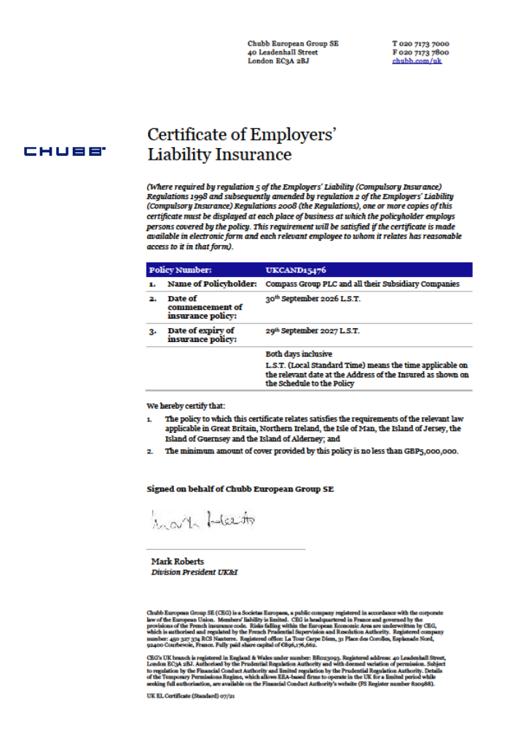
2026-2027 Liability Insurance Certificate
Available on the HSE website > Compliance > Certificates
Please update noticeboards
Double click image for the PDF
SEE CARE SHARE
WE LOOK OUT FOR EACH OTHER

Slide 8
Sexual Harassment & Third-Party
Risk Assessment
Required to be completed at unit level due to some recent new legislation
https://live.origamirisk.com/Origami/IncidentEntry/Direct?token=DNtMWu3CO%2Fy23a0TMn2BYLLpomD4WrV5azJdab7YuSO3bhKVAqx%2FSL4He2IU4T7sPpg8F1YLSB7iIHwfcC6UaeoAlVaBCy6scw6dd%2B6tHPqZSgwuhecMOsDXe5%2FWOUcO
Questions about the contents of it?
Contact the People Support Centre
SEE CARE SHARE
WE LOOK OUT FOR EACH OTHER

Slide 9
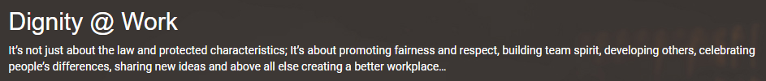


Sexual Harassment & Third-Party
Risk Assessment
My Learning courses
Speak Up portal on WorkJam
SEE CARE SHARE
WE LOOK OUT FOR EACH OTHER

Slide 10
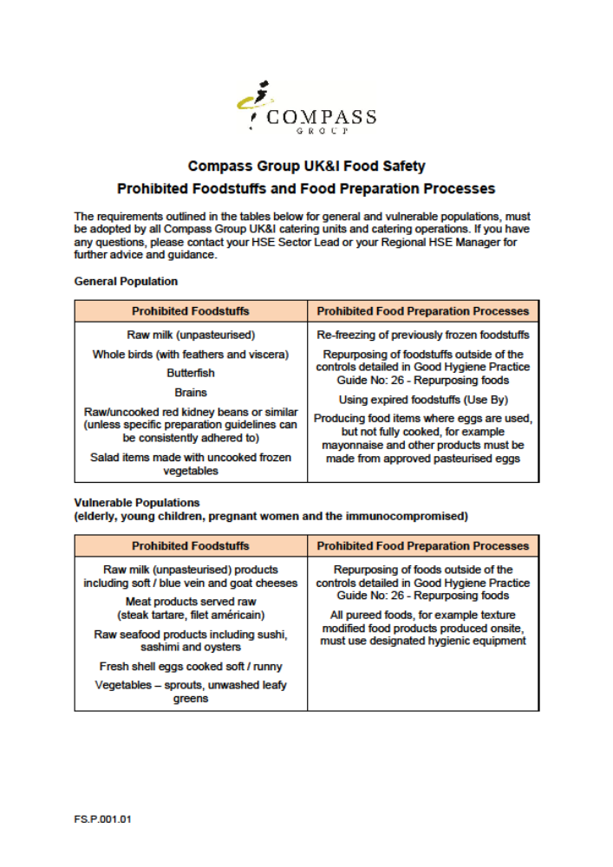
HSE Website updates
Double click image for the PDF
Clarification on Compass prohibited foods and prohibited food preparation processes
For further detail on egg dishes see GHP 9 Cooking
SEE CARE SHARE
WE LOOK OUT FOR EACH OTHER

Slide 11
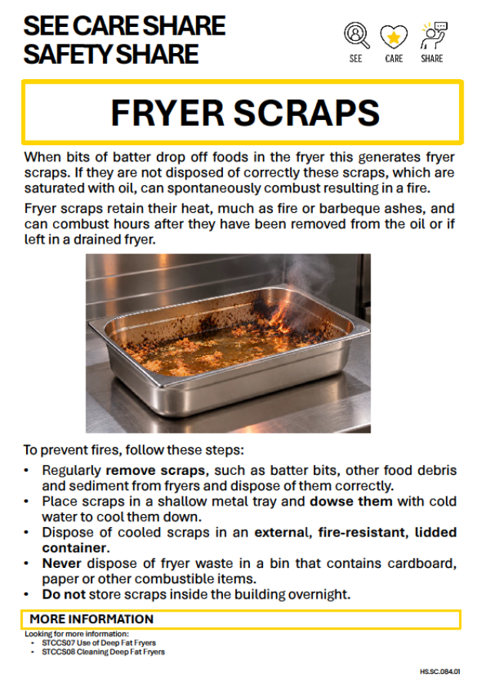
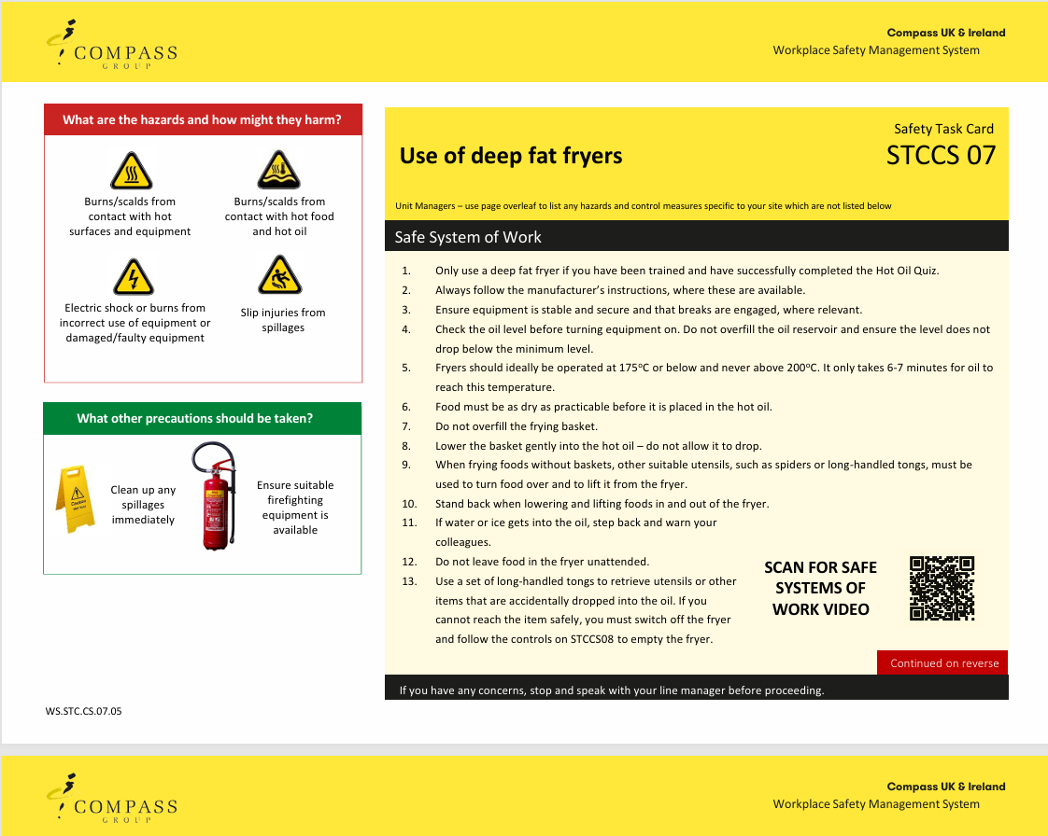
HSE Website updates
Double click image for the PDF
Brief your teams on the Safety Share
Update WSMS folders with the revised safety task cards and update the catering colleagues who use and clean the fryers
STCCS07 Use of Deep Fat Fryers
STCCS08 Cleaning Deep Fat Fryers
SEE CARE SHARE
WE LOOK OUT FOR EACH OTHER

Slide 12

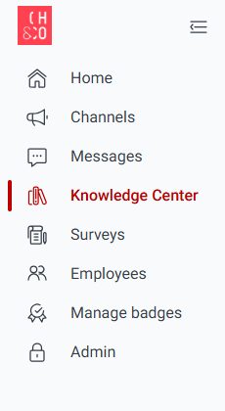

Our Planet Promise
Replaces the Net Zero Toolkit
As of 28.09.26 it is found in the Knowledge Centre on WorkJam

Slide 13

Our Planet Promise
There is a link to complete it online HERE
Or complete and save the PDF version
Or order a hardcopy from Linney if you wish
It is a mandatory requirement for all units to complete this
Double click image for the PDF
SEE CARE SHARE
WE LOOK OUT FOR EACH OTHER

Slide 14

Our Planet Promise
Complete and save it
Note: some actions will be irrelevant at your site. Mark these as N/A
If you are completing the PDF, don’t forget to record this via the QR code
Involve your team; share the planet-saving requirements with them
Review annually, or if there are any changes throughout the year
(or review and update if there is a change of manager)
SEE CARE SHARE
WE LOOK OUT FOR EACH OTHER

Slide 15

Our Planet Promise
Questions about the document or the contents of it?
Contact ourplanetpromise@compass-group.co.uk
Queries about equipment or services relating to Our Planet Promise?
Contact Foodbuy Helpdesk (Client Experience Team)
SEE CARE SHARE
WE LOOK OUT FOR EACH OTHER

Slide 16

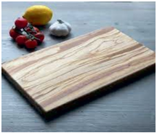
Wooden boards
GHP 11 Food Service & Display
Commonly used for hospitality events and finger foods
They should only be used to display lower risk foods such as cakes and pastries. They are also permitted to be used for cheeseboards and desserts
Must be free from cracks, crevices or damage, as this will harbour bacteria
Wherever possible, use parchment or film as a barrier between the food
and the board
SEE CARE SHARE
WE LOOK OUT FOR EACH OTHER
Notes:
This Photo by Unknown Author is licensed under CC BY-NC-ND

Slide 17
Before you leave this call!
Please can you type in the chat:
Site name
Name, email address and phone number of Unit Manager
Name of Ops Manager
Name and email address of head chef if they wish to be included in comms about audits and site visits
SEE CARE SHARE
WE LOOK OUT FOR EACH OTHER

Slide 18
Contacts
Michelle.howard@compass-group.co.uk
hse@compass-group.co.uk
Out of hours emergencies https://www.mycompasshse.co.uk/news/out-of-hours-hse-contact-wc-06012025/
SEE CARE SHARE
WE LOOK OUT FOR EACH OTHER

